Slide 1
Scope for Growth Career Conversations
Finding my place on the framework
Delivering the

Slide 2
Contents
Introduction | 03 |  | Definitions: Depth | 11
Overview | 04 |  | Finding my role in Breadth | 13
Benefits for the individual | 05 |  | Definitions: Breadth | 14
The Scope for Growth components | 06 |  | Finding my role in Stretch/Complexity | 16
Putting it simply | 08 |  | Definitions: Stretch/Complexity | 17
Finding my Scope for Growth position | 09 |  | Key points to remember | 19
Finding my role in Depth | 10 |  | FAQs | 20

Slide 3
Introduction
This document will take you through finding your place on the Scope for Growth framework.
Before you start, consider using the Scope for Growth personal reflection journal to help you clarify and confirm your career aspirations, which will make it easier to find your place on the framework.

Slide 4
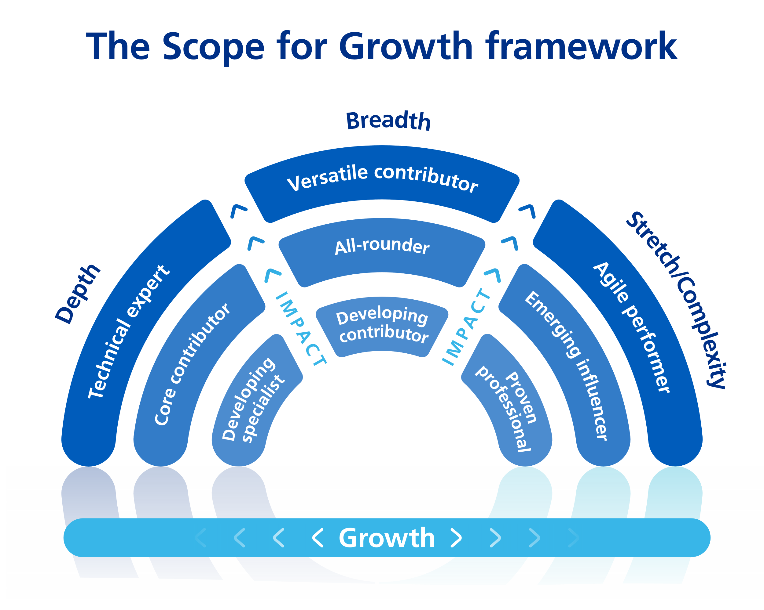
Overview
Scope for Growth
+ Puts staff in the driving seat of their careers and balances growth and impact with aspiration
+ Values all outcomes equally (depth, breadth, or stretch/complexity)
+ Supports career development by deepening and strengthening skills in current roles, as well as supporting those who are ready for the next step in their career
+ Helps make sense of each individual journey, deepening shared understanding of aspirations
+ Encourages a joint discussion to identify where an individual currently sits on the framework, where they want to move to and how they will do this
+ Outcomes are collected in ESR or similar employee or learning management system and used to build resourcing pipelines and development offers

Slide 5
Benefits for you
Scope for Growth – career conversations is a new approach to supporting personal growth and developing talent right across health and care.
It is designed to provide a framework for high-quality career conversations that help draw out an individual’s aspirations as well as their potential. Scope for Growth draws on evidence-based insights into understanding, nurturing, and developing all our people to be the best they can be.
Promotes confidence and resilience
Supports self-insight and self-awareness through reflection which helps establish identity; encourages learning from experience and instills confidence.
Activates imagination and creativity
Engaging in purposeful and positive social activity and being immersed in fulfilling and meaningful work promotes a more sustainable kind of well-being and a meaningful life.
Reduces stress
Individuals with a positive outlook are better equipped to deal with problems, resulting in reduced stress levels and higher performance.
Heightens drive to succeed
Supports all our people to develop drive and determination, build on their strengths, and accelerate their development.
Facilitates learning and innovation
Inspires and enables learning and development of new skills from a depth, breadth, and stretch/complexity perspective. This helps to instill a sense of growth, determination, and relevance.
Builds stronger, healthier relationships
Establishes psychological safety and trust though enabling career coaching conversations between line manager and individuals.

Slide 6
The Scope for Growth components
The Scope for Growth framework has three ambition categories.
Depth - expanding our people’s expertise in their chosen specialism or field
Breadth - building out our people’s careers into other areas
Stretch/Complexity - growing beyond current role, particularly around increasing complexity and leadership capabilities

Slide 7
The Scope for Growth components
It also has two axes, Impact and Growth.
+ The Impact axis refers to an underlying capability, along with their contribution to their team, organisation, and wider stakeholders. Impact is both what individuals do and how they do it. Performance in role will influence this axis.
+ The Growth axis refers to an individual’s personal ambition for growth across the three elements of depth, breadth and stretch/complexity.
Whilst the axes focus on impact and growth, another critical factor is individual aspiration. People may have the potential to grow or have greater impact but if their aspiration is to remain in the technical area of expertise or specialism, consolidate skills and knowledge, or simply do not want to consider a career move at that time, then this will be appreciated and accepted.

Slide 8
Putting it simply
Think about:
Remember:
+ Where are you now in terms of the ambition category of Depth, Breadth or Stretch/
Complexity?
+ Is this where you would aspire to be in the next 12-24 months?
+ Either consolidating skills or growing in impact?
+ If yes, then move to the more detailed descriptions in the ambition category
+ If not, then consider a different ambition category and try it out
+ You can discuss this with your line manager or coach to confirm your thinking
+ Consider your career development plan
+ This is a very personal journey and there is no right or wrong way to use the descriptions. You are in the driving seat of your career and will build plans based on very individual circumstances.

Slide 9
Finding my Scope for Growth position
Use the chart below to identify which ambition category you are currently in and then continue to identify and understand your current level of impact.
Next, think about where you want to be in the next 12-24 months. Do you want to stay in your current ambition category and level of impact? Or move into a different category - if so, select another ambition category and identify and read the aspired level of impact. Continue until you have a clear idea of where you are now in terms of your Scope for Growth position and where you want to be in the next 12-24 months. Discuss your Scope for Growth profile with your line manager, coach or trusted colleague as part of your career conversation.
Start Here
Do I want to stay in my current role/ discipline/function and continue to grow in this field/profession?
Do I want to stay in my current discipline but broaden my role/knowledge/expertise into other areas or functions?
Do I want to move from my current role into another role, perhaps one with greater complexity and/or leadership impact?
No
No
Yes
Yes
Yes
I am in Depth
I am in Breadth
I am in Stretch/ Complexity
Depending on whether you agree ‘yes’ to Depth or Breadth or Stretch, click the ambition box to find the matching description.

Slide 10
Finding my role in Depth
Restart
Continue Here
I am in Depth
Do I want to advance in this field or develop my potential in this area?
Do I want to stay in this role or move to similar role in the team?
Am I considering developing and broadening my experience?
No
No
Yes
Yes
Yes
I am/aspire to be a technical expert
I am/aspire to be a core contributor
I am/aspire to be
a developing specialist
Decide if you agree ‘yes’ to technical expert or core contributor or developing contributor. Then review the associated role description in more detail on the Scope for Growth Framework to confirm your place.

Slide 11
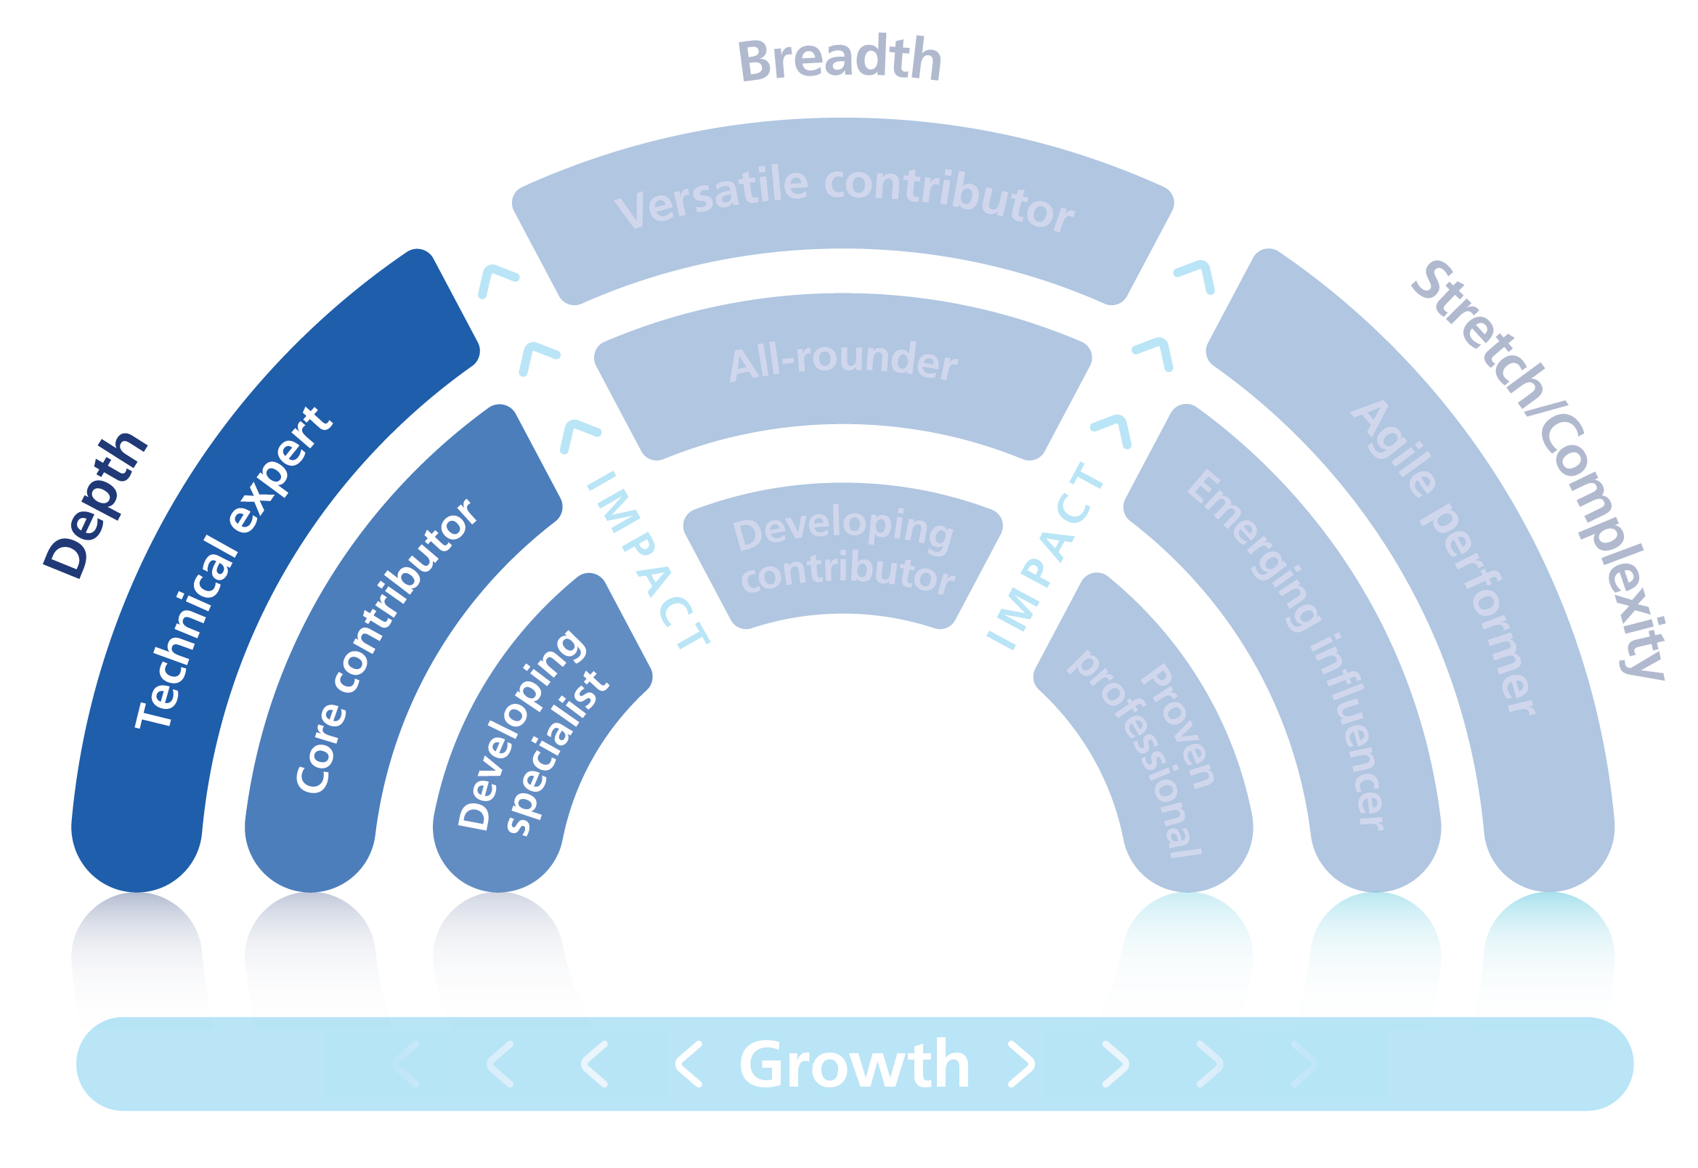
Definitions: Depth
Depth is about expanding our people’s expertise in their chosen specialism.
They have a desire to advance in their professional field without increasing the scale or complexity of their role.

Slide 12
Technical expert
Core contributor
Impact:
Developing specialist
Impact:
Impact:
+ Operating at a high level of impact in a technical and team environment
+ Embraces change an early adopter
+ Driving long term transformation in their area of expertise
+ Shares knowledge with others with technical learning
+ Is considered the go to person for their skill
+ Positive impact is consistently achieved and
demonstrates technical capabilities
+ Potential to further develop in their current area of expertise e.g. Prefers to stay within their current specialism
+ Operating well and consistently in current role
+ Growing impact in current area of expertise
+ Growing contribution to the organisation’s/ team’s goals
+ Demonstrates technical capabilities and is growing
+ Positive impact
+ Potential to develop in their current role
+ Developing impact in current area of expertise, developing technical capabilities and awareness of impact on others
+ Possibly new to role or for whom the fit to role is not a good match
+ May need to deepen knowledge and skills to create an impact or require time to settle into role
Growth:
+ Not known at this time
Development:
Growth:
+ Ability, desire and commitment to move into a different role of current size or complexity within the same team or discipline, or happy to stay with current role
+ Consolidate experience in current role
+ Develop impact and influencing skills
+ Strengthen stakeholder relationships
+ Develop relevant technical knowledge and skills
+ Deepen NHS/organisation/system and role specific knowledge
+ Work with a local buddy.
Depth
Development:
Growth:
+ Potential to advance in their professional field
+ Could take a wider role if they develop their current potential and are determined to do so
+ Increase NHS/system exposure and networks externally
+ Technical knowledge and skills development
+ Mentoring
+ Internal secondment/move
+ Learning and development via Leadership Academy/Regional/system and organisation offers.
Development:
+ Draft expert papers
+ Educate, develop and mentor colleagues
+ Senior mentoring/sponsor
+ Gain professional qualifications
+ Taken on external secondment
+ Champion knowledge sharing across area of expertise and share best practice
+ Present at national events & conferences, recognised for technical expertise.

Slide 13
Finding my role in Breadth
Restart
Continue Here
I am in Breadth
Do I wish to move into significantly larger roles within a similar function or discipline?
Do I have the desire to broaden my experience into other areas within my current expertise?
Am I new in my current role and / or still developing my capability and impact?
No
No
Yes
Yes
Yes
I am a versatile contributor
I am an all rounder
I am a developing expert
Decide if you agree ‘yes’ to versatile contributor or all rounder or developing expert. Then review the associated role description in more detail on the Scope for Growth Framework to confirm your place.

Slide 14
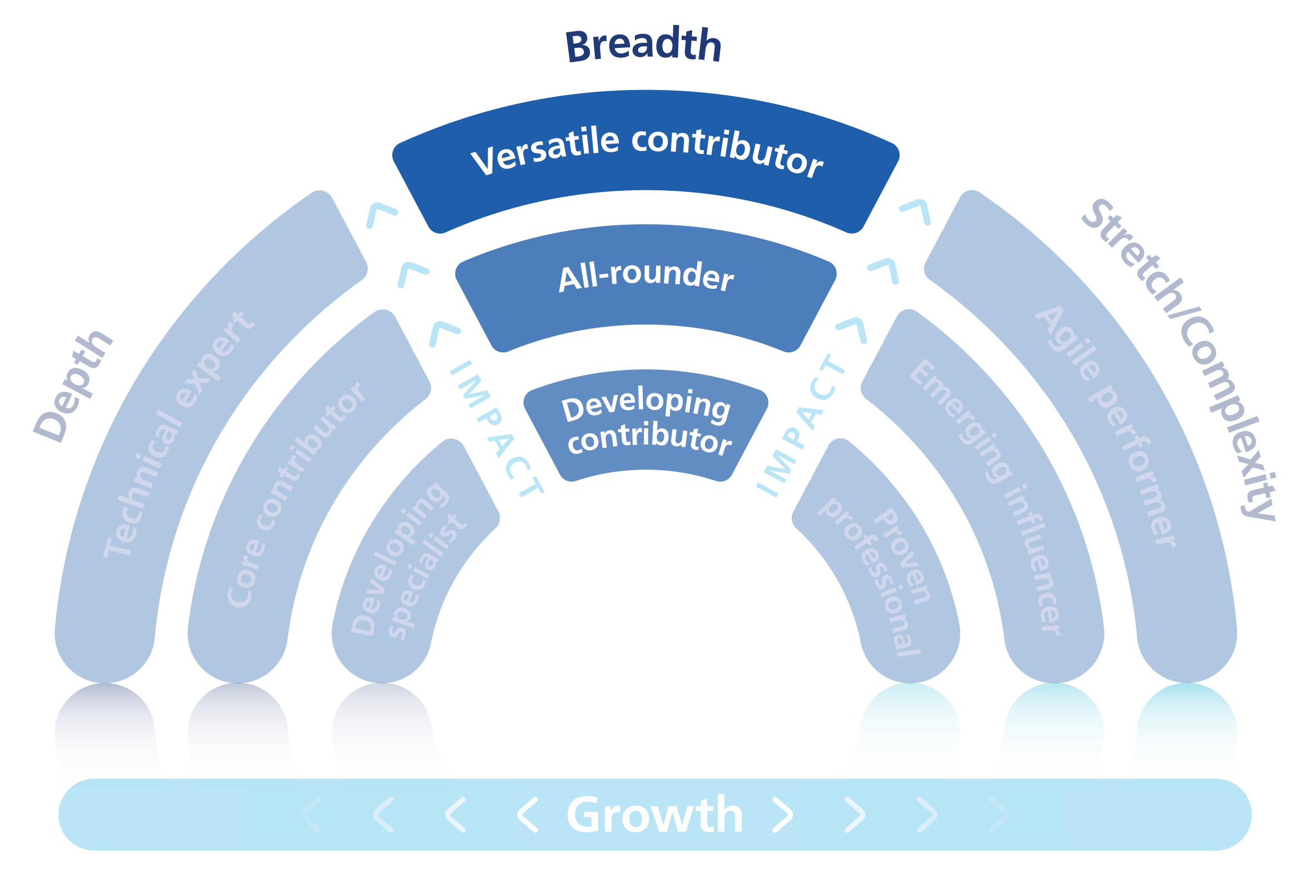
Definitions: Breadth
Breadth is about building our people’s careers beyond a single specialism. They have a desire to move into larger or more complex roles within a similar function or discipline.

Slide 15
Versatile contributor
All-rounder
Impact:
Developing contributors
Impact:
Impact:
+ Operating at a high level of impact in a technical and team environment
+ Significant impact in current area of expertise
+ Actively shares building skills and technical knowledge with others
+ Is considered the lead for their particular skill
+ Positive impact is consistently achieved and demonstrates technical capabilities
+ Potential to further develop in their current expertise area
+ Works across other organisational areas
+ Operating well and consistently in current role
+ Growing impact in current area of expertise
+ Growing contribution to the organisation’s goals
+ Demonstrates technical capabilities, personal strengths and has an increasing positive impact
+ Potential desire to broaden experience
+ Developing impact in current area of expertise, developing technical capabilities and awareness of impact on others.
+ Possibly new to role or for whom the fit to role is not a good match.
+ May need to deepen knowledge and skills to create an impact or require time to settle into role
Growth:
Growth:
+ Potential to broaden experience in other areas, related to their current expertise.
+ Showing strong ability, desire and commitment to move into significantly larger roles or more complex roles within a similar function or discipline as now
+ Potential to develop into other areas
+ Potential desire to broaden experience
+ Expected to have an impact in the future and shows the ability, desire and commitment in their current role
+ Demonstrates a good understanding of team organisational strategic objectives and values
Growth:
+ Showing exceptional ability, desire and commitment to move into significantly larger roles or more complex roles within a similar function or discipline as now
+ Consider broadening to wider roles in the future
Breadth
Development:
+ Take on projects outside current team or function
+ Increase NHS/system knowledge and networks externally
+ Mentoring
+ Internal secondment/move
+ Learning and development via leadership academy/ region/local system/organisation.
Development:
Development:
+ Take on cross function/organisation/system projects
+ Undertake management/leadership development to improve capacity and capability
+ Senior merntoring /sponsor
+ Take on external secondment
+ Strategic project accountability
+ Increase exposure to wider strategy and transformation
+ Gain professional qualifications
+ Get to know counterparts in other NHS, Health & Social Care & other aligned sectors
+ Increase understanding around governance and assurance
+ Champion knowledge sharing across wider teams/ organisation and share best practice to prevent silo working
+ Consolidate experience in current role
+ Develop impact and influencing skills
+ Strengthen stakeholder relationships
+ Develop relevant technical knowledge and skills
+ Deepen NHS/organisation/system and role specific knowledge
+ Work with a local buddy.

Slide 16
Finding my role in Stretch/Complexity
Restart
Continue Here
I am in Stretch/ Complexity
Do I have transferrable skills to move into larger or more complex/bigger leadership role?
Do I wish to develop in generalist areas with a degree of ambiguity outside my current role?
Do I wish to move on to a more stretching role?
No
No
Yes
Yes
Yes
I am an agile performer
I am an emerging influencer
I am a proven professional
Decide if you agree ‘yes’ to versatile contributor or all rounder or developing expert. Then review the associated role description in more detail on the Scope for Growth Model to confirm your place on the model.
Record where you have placed yourself on the Scope for Growth model in your reflection journal and discuss this with your line manager during your career conversation.

Slide 17
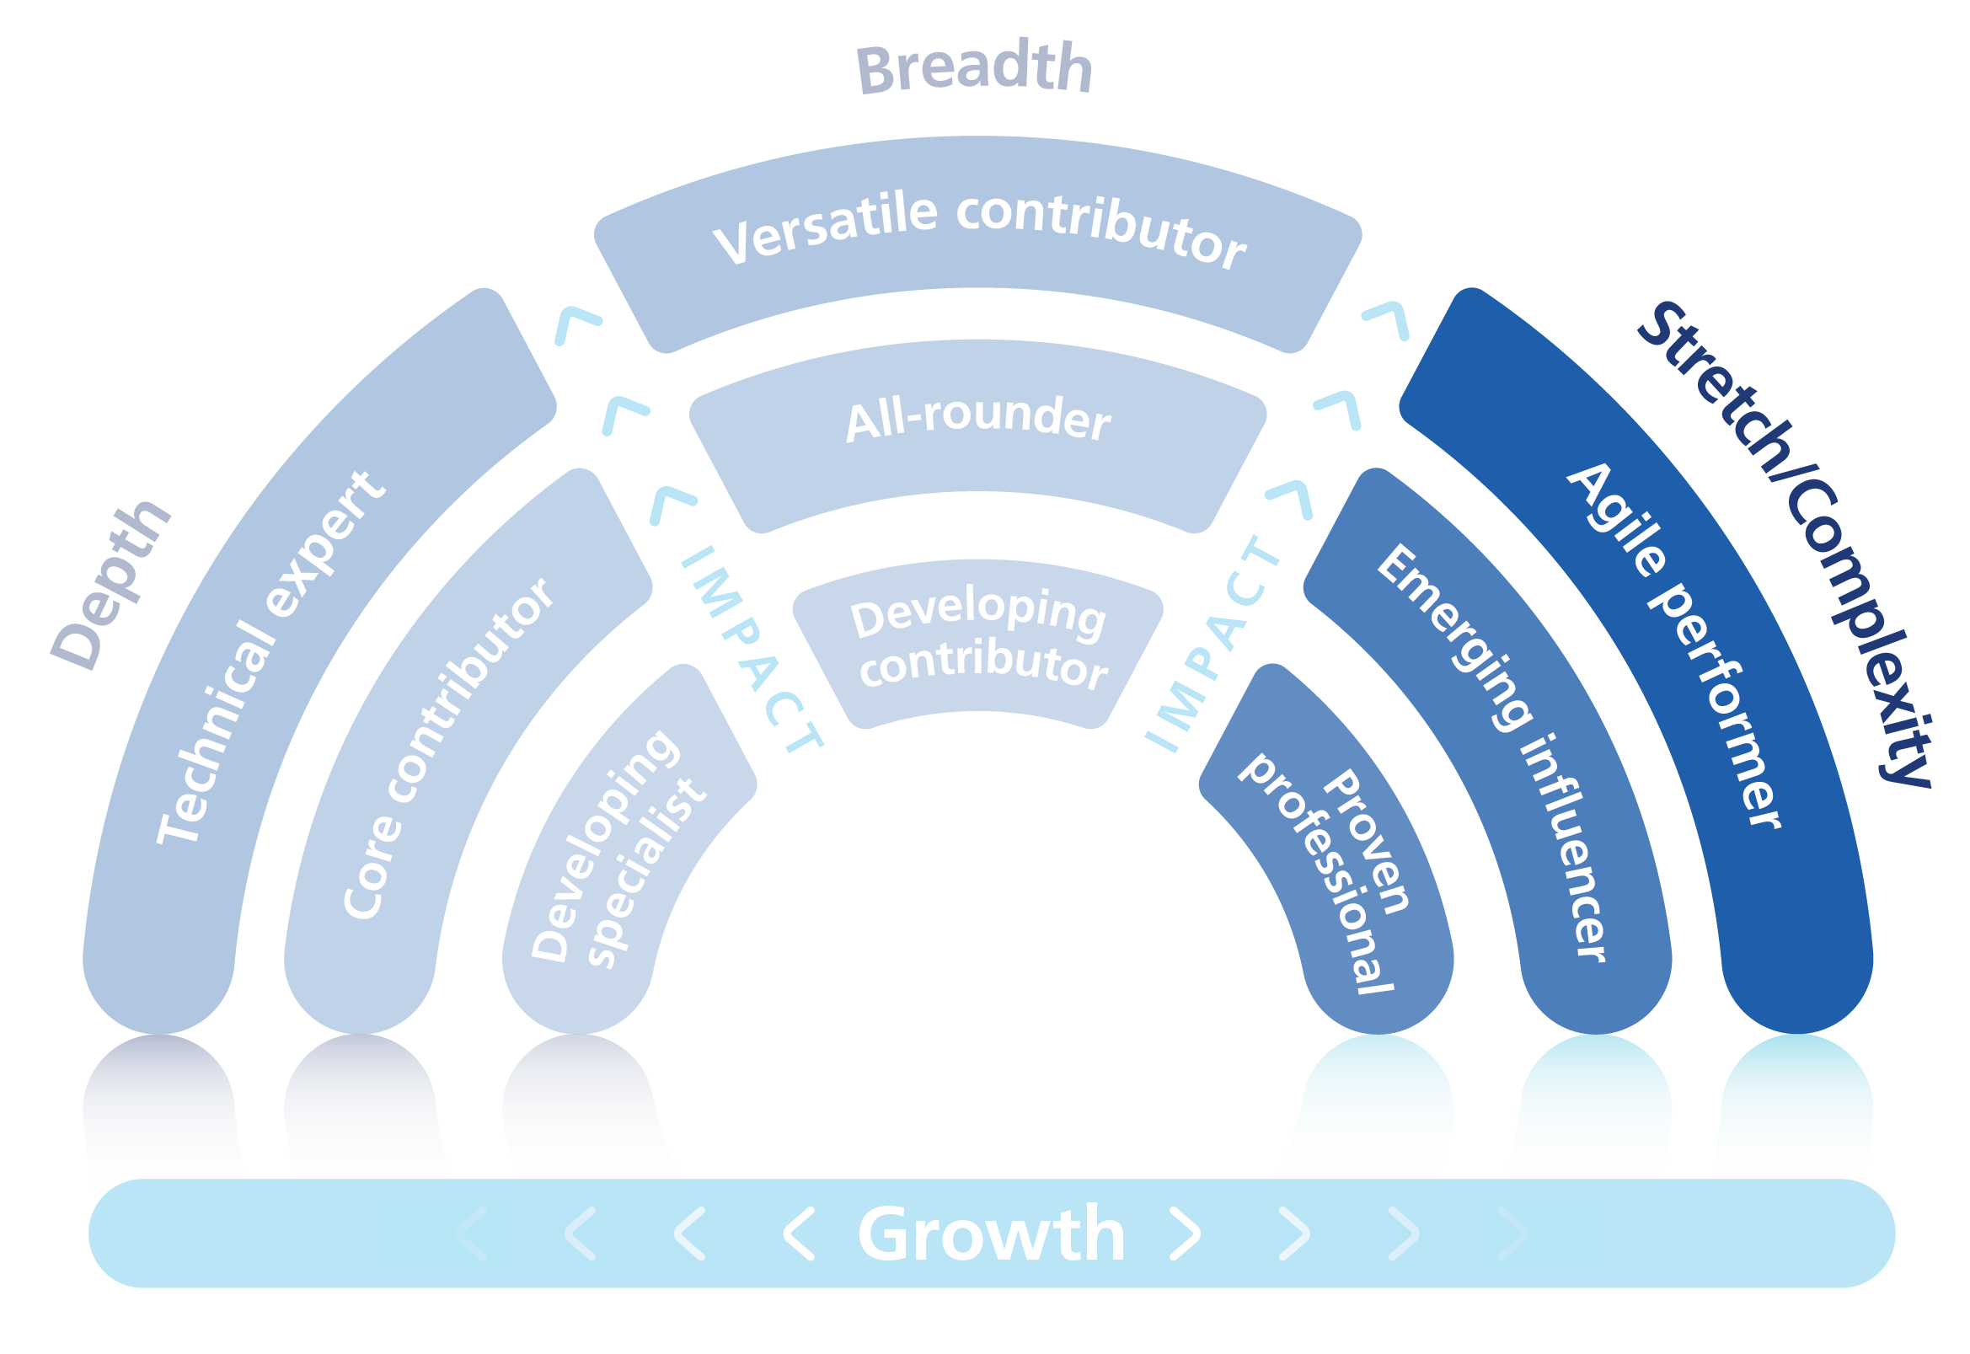
Definitions: Stretch/Complexity
Stretch/complexity refers to people growing beyond and surpassing their current role and expectations. They have the desire to move to positions of greater complexity and influence, and increasing in leadership scale and capabilities.

Slide 18
Emerging influencer/ Emerging Potential
Agile Performer/Future Potential
Impact:
Proven Professional/ Stretch Potential
Impact:
+ Significant impact in multiple areas of expertise and across the organisation
+ Significant impact on the overall organisation’s goals
+ Positive impact and role model of inclusion, NHS’s constitution and values, personal strengths and leadership capabilities
Impact:
+ Operating well and consistently in current role
+ Growing impact in current area of expertise
+ Growing contribution to the organisation’s goals
+ Demonstrates technical capabilities, personal strengths and values and has an increasing positive impact
+ Developing impact in current area of expertise, developing technical capabilities and awareness of impact on others
+ Possibly new to role or for whom the fit to role is not a good match
+ May need to deepen knowledge and skills to create an impact or require time to settle into role
Growth:
+ Showing exceptional ability, desire and commitment to move into significantly larger or more complex/bigger leadership role with the transferrable skills to potentially move into other parts of the organisation as well as within their current function
+ Determined to seek involvement in a wide range of challenges outside specialism and/or move to wider and more complex roles
Growth:
Growth:
+ Potential to develop in generalist areas, with a degree of ambiguity, outside current role
+ Determined to seek involvement in a range of challenges outside specialism and/or more to stretching roles
+ Desire to move onto stretching roles
+ Determined to seek involvement in a range of challenges outside specialism and/or move to other roles
+ Expected to develop to perform in future and shows the ability, desire commitment and transferable skills to move into other parts of the organisation as well as within their current function
+ Proven entity in current and past roles, potential to apply impact
Stretch Complexity
Development:
Development:
+ Formal leadership development to improve capacity and capability
+ Increase leadership impact (e.g., motivate and deliver change and through other people)
+ Active in external networks
+ Senior mentoring/coaching/sponsor
+ External secondment
+ Strategic project accountability
+ Increase exposure to wider strategy and long-term transformation
+ Improve understanding of national agenda and the political context outside current organisation into partnerships and wider communities
+ Gain wider leadership experience/accountability
+ Increase understanding around governance and assurance
+ Gain experience in delivering high-quality and sustainable outcomes.
+ Consolidate advanced knowledge and experience in current role
+ Apply best practice to continue to develop internal and external networks
+ Acting up opportunities
+ Mentoring/coaching/sponsors
+ Improve understanding of the wider service at national, regional and local levels
+ Build strategic longer term thinking (i.e. broad not narrow)
+ Take on organisation-wide responsibilities
Development:
+ Proactively build external networks in new field/level
+ Coaching
+ Develop higher level capabilities/insight
+ Develop impact and influence skills with more senior stakeholder groups.

Slide 19
Key points to remember
+
Your aspirations and career development plans are unique to you
By using the Scope for Growth reflection journal you will be able clarify and confirm your career aspirations, which will make it easier to find your place on the Scope for Growth framework
All aspirations are valued, whether you are fast tracking into more senior roles or consolidating skills and knowledge and not considering a career move at this time
Aspirations do change over time and it is helpful to revisit your Scope for Growth - career conversation and position on an ongoing basis
+
+

Slide 20
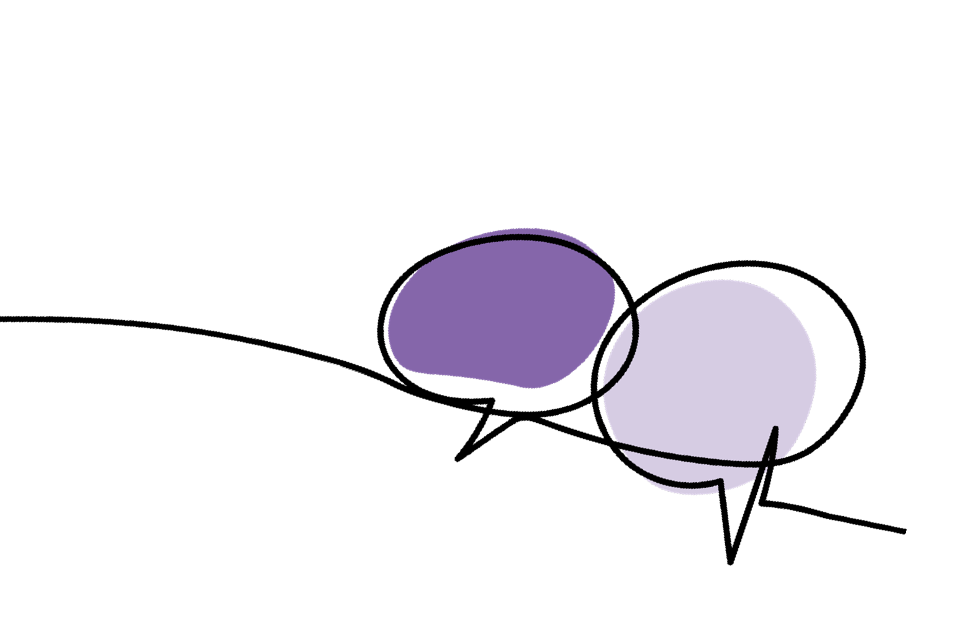
Your questions … answered
Q. Can I be in more than one ambition category?
Q. What if I am happy in my current role and want to stay where I am?
A. You may identify with more than one description.
It is recommended that you select a preference
to prioritise as this will help you to create a focussed and achievable career development plan. You may have shorter time frames than 12-24 months and can revisit your plan and have more regular talent conversations.
A. That is absolutely fine. If you are happy in your current role, that will be respected and appreciated. You are in the driving seat of your career. The Scope for Growth framework is designed to help you create a development plan that meets your needs.
Q. Do I have to progress across each ambition category in a particular order?
A. No. The framework is flexible. Where you position yourself will be decided by your personal reflection and career conversations.

Slide 21
Delivering the
21

