Slide 1

How to use this training package:
This training has been built to be facilitated by organisations, training those who will be holding Scope for Growth conversations - this may include line managers, coaches and mentors.
The aim of this training is to support line managers, coaches & mentors (etc.) to understand the framework and model, provide an opportunity for practising holding the conversation in a safe environment and a coaching style conversation.
This is a generic training package, which can be adapted for localised use. Some slides may also be omitted if they are not relevant to the organisation or audience.
This training has been built to be used in either a face-to-face or online environment. A facilitator script and notes have been included under each slide to support those delivering the training.
Hidden slides are optional to use should they be relevant to the organisation or useful for facilitation purposes.
Key: Navigating materials
​​ | The ‘X' icon indicates where a slide may be omitted if it does not provide relevant information needed for an organisation
​​ | The 'thinking plus' icon indicates this slide may benefit from local adaptation.​​

Slide 2

Scope for Growth Career Conversations
Date
Delivering the
Notes:
Facilitator notes:
Timings
Allocate at least 2.5 hours for this training. This will include a 10-15 minute break.
The session can be shorten if you decide not to include the break out sessions. However, we recommend that this is included where possible as it allows individual to practise the framework in a safe space.
Break out sessions total 60mins of the session time.
Numbers
This may depend on whether you are holding the training face-to-face or online.
Generally, we would recommend for around 16 delegates. However this can be flexible with good time management.
Invitation:
It is recommended that you attach the below supporting documents to the calendar invitation:
Information for managers: Information-for-Line-Managers.pdf (leadershipacademy.nhs.uk)
Facilitation Guide for Line Manager or Coach: Aspirational-Conversation-Facilitation-Guide.docx (live.com)
Reflection Journal: Reflection-journal-_type-fields_.pdf (leadershipacademy.nhs.uk)
Finding my place on the framework: Finding-my-place-on-the-framework.pptx (live.com)
Aspirational Conversation Development Plan: Aspirational-Conversation-Development-Plan-2.pdf (leadershipacademy.nhs.uk)
Aspirational Development Initiatives: Scope-for-growth - PHASE 3 and 4 - DIAGRAMS-10 (leadershipacademy.nhs.uk)
Activities:
If you are conducting the training online, it is recommended that you create break out rooms in advance, where pairs will work together. We recommend that the pairs stay the same throughout the training to allow them to work through the whole scope for growth conversation together. Where possible, it is recommended that you pair individuals that don’t often work together. This will allow individuals to try out the framework without fear of judgement.
If you are doing the training face-to-face, ensure there is enough space available for people to work together in pairs away from others.
If you are face-to-face, we would recommend providing the Aspirational Develop Plan & Finding my place on the framework as session handouts.
Branding
This training package has been created using NHS England and the People Promise branding. You may convert this to your own organisational branding if required.

Slide 3
Welcome!
Introductions
Your name
Your role
What are you looking to get out of today?
Notes:
Facilitator Notes:
Welcome the delegates into the training day.
If this is small number, ask delegates to share the information going round the room (or in a digital meeting).
If this is a large number and online, ask delegates to share this information in the chat

Slide 4
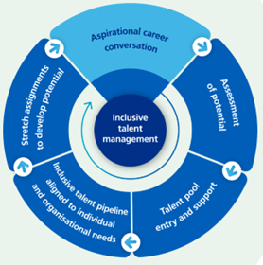
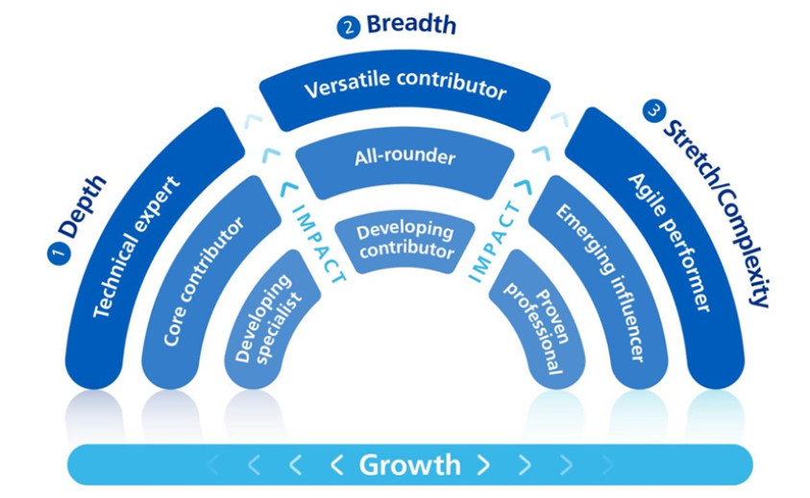
Purpose of Today
What is Scope for Growth
Understanding the Framework and model
Explore the framework and model together
Notes:
Facilitator Script:
Scope for Growth aims to support personal growth and the development of talent right across health and care. It is designed to provide a framework for high-quality career conversations that help draw out an individual’s aspirations as well as their potential. It is a future-focused, person-centred approach in which everyone is supported and encouraged to take ownership of their own development through coaching style conversations that prioritise well-being, as well as professional development and career aspirations.
The purpose of today is to build your understanding of the Scope for Growth career conversation framework and model. During today’s session we will explain the purpose behind Scope for Growth, its features and how to use it. We will also provide you with an opportunity to use the framework and practice is a safe environment.

Slide 5






Why do we need Scope for Growth? We need an approach to talent that...
is consistent so needs, gaps and opportunities can be considered within and across organisations working in a system enabling us to best fill critical roles and enhance care
enables delivery of the Long Term Workforce Plan and the People Promise by building in discussions on health and wellbeing, aspiration, performance and potential
intentionally fosters a culture of inclusion, belonging, celebrates diversity and makes aspirations of our people 'more visible' (supporting the NHS ambition for 19% BAME board membership by 2025)
supports aspirations, places our people in the driving seat of their career and contributes to a positive experience of working in health and care
aligns not only with the current challenges our workforce is facing as we emerge from the pandemic but also the unprecedented challenges as we navigate economic and environmental volatility
Notes:
Facilitator Script:
To begin with, we wanted to provide you with an overview of where Scope for Growth has come from.
Scope for Growth was developed by NHS England in order to create a consistent approach to developing our talent and therefore supporting a system way of working.
This approach enables us to deliver on the Long-Term Workforce Plan and People Promise, by discussing the health and wellbeing of individuals in addition to their performance and potential.
Scope for Growth has been developed to intentionally foster a culture of inclusion by making everyone’s aspirations more visible and therefore supporting our EDI aspirations.
Through this, we are able to put people in the driving seat of their career and therefore drive a positive experience of working within health and social care
And finally, we know that we are facing challenges across our workforce, particularly after the pandemic. Scope for Growth has been designed to enable individuals to have positive career conversations and therefore support retention
Facilitator Note:
The purpose of this slide is to provide context around how Scope for Growth was developed by NHS England, it may be worth reflecting on how useful it is for your audience to understand this.

Slide 6
Organisational Strategy - optional
Notes:
Facilitator Notes:
Insert your organisation’s goals/people strategy – how does the Scope for Growth framework support the achievement of this?

Slide 7
How is the approach different?
Give power to individuals to take ownership
Coaching-informed approach
Prioritises personal well-being and fulfilment
Prioritises ongoing development and career aspirations
Applicable and available to all - across system, any level, any profession
Move beyond conversations that focus on past performance
Takes a holistic view of the person
Recognises progression is not always linear
Inclusion as a golden thread underpinning all
Notes:
Facilitator Script:
The Scope for Growth career conversation approach is seen differently to other career conversation models for a number of reasons.
This framework is applicable and available to all colleagues, regardless of where they are in terms of banding or profession. This makes this a truly inclusive talent management tool.
The Scope for Growth Framework also enables you to have conversations with individuals that go beyond their past performance and look forward to their future aspirations.
In doing so, we are giving individuals the power to take ownership of their own career and support them to be motivated to reach their aspirations.
The Scope for Growth framework is a coaching-informed approach, with you acting as the coach by guiding individuals through the conversation and support them to think deeply about what they are looking to achieve in the next steps of their career. For a coaching approach, this includes asking open questions (such as what, when, how), engaging in active listening and reflecting back what you have heard from the individual to support deeper reflections. Here you will to be looking to understand their perspectives rather than feeding back your own. This is different to a mentoring approach, where you would offer guidance or your own perspectives. The support documents will provide you with guidance on coaching questions which can you when working through the Scope for Growth framework.
The framework seeks to support a holistic approach of the person. It does this by seeking to understanding the individual’s values and taking their health and wellbeing into consideration. Here, you are seeking to learn more about the individual as a whole person.
The framework recognises that progression is not always linear and does not always mean a promotion but celebrates diverse careers
By supporting individuals to share their values, aspirations and what will support their wellbeing, you will be able to support individuals to achieve personal wellbeing and fulfilment. And in turn support us to have an engaged and thriving workforce.
And therefore, support the organisation to drive ongoing development and career aspirations throughout an individual’s full career journey and cycle.
Given the above, inclusion is the golden thread underpinning all of these items, where people’s diversity of thought and career aspirations are celebrated and appreciated.
Optional Facilitator Script: This approach is different than traditional talent and career conversation tools, including 9-Box Grids and the Maximising Potential model previously endorsed by NHS England. These approaches focused more on current job performance, had a short-term viewpoint and essentially ‘put people in a box’. Moving to an individual-led rather than manager-led framework motivates individuals to manage their own careers, whilst strengthening relationships with line managers (or coaches/mentors) and supporting individuals to have long, diverse and motivating careers within health and care.
Facilitator Note:
It may be important that any previous organisation-specific processes are referenced here. For example, if you are using Scope for Growth to replace a current procedure, explain how Scope for Growth is different and the benefits it brings in comparison.
If your audience is very new to a coaching approach, use the Coaching Skills module on the Leadership Learning Zone to support them to gain this understanding. (NHS Leadership Academy | Supporting you to reach your leadership potential (leadershipnhs.uk)). This could be used as pre or post programme work.
Additional resources include:
Deep listening and holding space – Leadership Academy
Compassion and inclusive leadership – Leadership Academy
Coaching and Mentoring Apprenticeships – Leadership Academy
Resources: Leading Reflection – South West Leadership Academy (South West Leadership Academy)

Slide 8
How will the approach help?
It is intended that delivering a Scope for Growth – Career Conversation will be an opportunity for Line Managers/Coaches/Mentors to:
Connect with people from a position of curiosity and positivity.
Use the framework and model to hold high quality career conversations that energise.
Empower ownership in current role, development and future career
It is intended that delivering a Scope for Growth – Career Conversation will be an opportunity for individuals to:
Experience a safe space to discuss strengths, future aspirations, contribution and identify practical development steps
Experience an in-depth person-centered conversation
Take ownership in current role, development and future career
Notes:
Facilitator Script:
So, how does this approach help a manager/coach/mentor and the individual
As a manager/coach/mentor…
Your role will be to connect with people from a position of curiosity and positivity. It is their conversation and your role is to guide then to support their own aspirations.
The framework and model will enable you to have a high-quality career conversation, where you will be able to energise individuals to think deeply about their career aspirations
Finally, you will be therefore empowering and enabling them to take ownership of their future careers
As individuals, they should receive…
A safe space to reflect upon and discuss their strengths and future aspirations, without judgement
A conversation which is completely focused on them, without other influences
An opportunity to be motivated to take ownership and therefore be more energised in their career

Slide 9
Creating Conditions for Success
Notes:
Facilitator Script:
To enable the safe spaces we’ve indicated, as a line manager/coach/mentor, it is important that you create conditions for success, where individuals can be open with the information they share with you.
We will now take you through a number of conditions for success that need to be considered when conducting your Scope for Growth conversations. These will also support our organisation to work towards achieving the NHS People Promise.
Facilitator Note:
If there a requirement for further manager training/support for creating conditions for success, e.g. supporting psychological safety, there is information and resources included within the Information for Managers Document

Slide 10
Stimulate a sense of belonging
Create positive, purposeful environments where everyone can flourish
Listen well and be compassionate
Help people feel connected to and supported by each other
Notes:
Facilitator Script:
A by-product of the Scope for Growth conversation is that we looking to achieve a sense of belonging within our workforce.
To enable this, we need to create a positive purposeful environment, where everyone can flourish
As a manager/coach/mentor, it is your role to listen well and be compassionate. Being compassionate will be vital when discussing the individual’s health and wellbeing and values
Scope for Growth career conversations is also a way to demonstrate how we can create new opportunities to connect each other and share insights and learning to career development
Facilitator Note:
To support further learning, you may want to guide delegates to engage with the Kindness in Leadership module on the Leadership Learning Zone
NHS South West Leadership Academy | Supporting you to reach your leadership potential (leadershipnhs.uk)

Slide 11
Create psychological security
Build inter-personal trust
Focus on well-being
Offer support
Notes:
Facilitator Script:
Creating a sense of psychological security will be crucial to having an in-depth conversation, where the individual feels they can be honest and that you are invested in understanding their career aspirations.
To do so, you will need to:
Build inter-personal trust with the individual. This may rely on your relationship with the individual prior to the meeting
Focus on well-being, this will be particularly important at the beginning of your scope for growth conversation. It is important that you acknowledge what an individual tells you about their well-being and you are there to listen
And by truly understanding their situation, you will be able to offer support to individuals and demonstrate that you are empathetic
Facilitator Note:
If you need additional training and resources on psychological safety, you can share this video:
Building a psychologically safe workplace | Amy Edmondson | TEDxHGSE - YouTube

Slide 12
Use a coaching approach
Ask open questions
Reflect back what’s said
Offer constructive challenge using data where appropriate
Notes:
Facilitator Script:
The Scope for Growth career conversation framework is built on a coaching approach in order to support individual to take ownership of their conversation, with your role to support this conversation and enrich it through:
Asking open questions to support deeper reflection
Reflect back what the individual has said to you. Often hearing your own words said back to you can help you to reflect further as hear externally. This also helps to ensures you as the line manager/coach/mentor has understood what they are trying to tell you
Offer constructive challenge using data where appropriate. This may come in the form of positive affirmations where an individual is lacking confidence in their own abilities. Draw upon examples of their good work to help motivate them
Facilitator Note:
If your audience is very new to a coaching approach, use the Coaching Skills module on the Leadership Learning Zone to support them to gain this understanding. (NHS Leadership Academy | Supporting you to reach your leadership potential (leadershipnhs.uk)). This could be used as pre or post programme work.
Additional resources include:
Deep listening and holding space – Leadership Academy
Compassion and inclusive leadership – Leadership Academy
Coaching and Mentoring Apprenticeships – Leadership Academy
Resources: Leading Reflection – South West Leadership Academy (South West Leadership Academy)

Slide 13
Focus on the future
Think about potential
Use past performance as data rather than a predictor
Be open and responsive to new ideas and possibilities
Notes:
Facilitator Script:
The Scope for Growth career conversation is all about focusing on an individual’s future and how we can support them to fulfil their aspirations.
Therefore, the conversation should focus on the individual’s potential and how this aligns to their aspirations
Past performance should be data or evidence of skills, knowledge etc, but not as a predictor for the future
Demonstrate that you are open and responsive to any new ideas and possibilities an individual may have. They may have ambitions to do something very different to what they are doing now and this should be supported

Slide 14
Appreciate difference
Know that people will want different things
Understand that people can change over time
Expect that people will have different attitudes to these conversations
Notes:
Facilitator Script:
This conversation should also be seen as a vehicle for appreciating difference and acknowledging that people will have different ambitions.
It is important that you know that people will want different things. For example, whilst individuals may have the skills and knowledge to move into more senior roles, this may not align to their ambitions.
Understand that people can change over time. This includes ambitions changing, or whether a new experience may motivate them to change their aspirations. Likewise, it should be acknowledged that individual’s circumstances at the time of the conversation may not allow them the capacity to act on their ambitions. In this case it important to acknowledge this and check in on whether circumstances have changed and assess their degree of ‘readiness’ to take on developmental initiatives
Expect that people will have different attitudes to having a career conversation. For some this will be extremely motivating and not for others. It might be important to work with those with negative perceptions of these conversations to understand where this might be coming from. For example, have they been promised opportunities in the past, but these haven’t been delivered on and advise that Scope for Growth conversations are built put them in the driving seat, rather than being manager-led.

Slide 15
Harness the talent of people from under-represented groups
Be aware of their conscious and unconscious bias
Understand the barriers to progression for people from under-represented groups
Build confidence and open doors
Notes:
Facilitator Script:
As discussed earlier, the Scope for Growth framework is for everyone, at any level and is there an important tool for supporting the talent of people from under-represented groups.
In order to support this:
Be aware of your conscious and unconscious bias and how they may impact how you are approaching conversations with individuals.
Understand the barriers to progression for people from under-represented groups. When an individual discusses this with you, listen and acknowledge what they have shared and consider how you have support the removal of these barriers.
Support individuals to build their confidence and open doors where you can
Facilitator Note:
To support further learning, you may want to guide delegates to engage with the Unconscious Bias and Equality & Diversity modules on the Leadership Learning Zone
NHS South West Leadership Academy | Supporting you to reach your leadership potential (leadershipnhs.uk)

Slide 16
Creating a psychologically safe space – group discussion
How would you create the conditions for a safe and inclusive Scope for Growth Career Conversation to take place?
Notes:
Facilitator Script:
Considering everything you have just heard, we thought it would be good to have group discussion around how would you create the conditions for a safe and inclusive Scope for Growth career conversation?
Facilitator Notes:
This is an open group discussion, ask people to raise their hands if online.
If the group is struggling to begin with, it might be worth offering some insights you have or sharing information about what ‘active listening’s is. Alternatively, ask the group to share what has happened for them when they have felt safe to have a conversation like this in the past, how was that achieved?
Additionally, if this audience are mainly clinical, you may ask them to consider the practical elements of having this conversation – e.g. booking out time to focus on this conversation, ensuring there is a meeting room available instead of in a staff break room or on a ward.
Activity Time: 10 minutes max

Slide 17
The Scope for Growth Framework
Notes:
Facilitator Script:
We will now take the through each stage of the Scope for Growth framework and give you opportunities to test it out

Slide 18
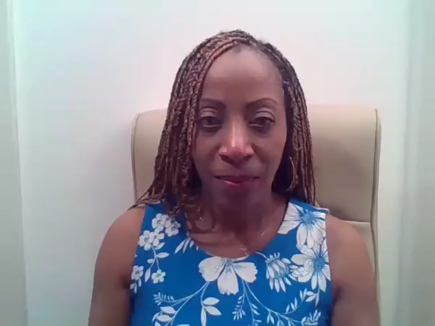
What is Scope for Growth?
Notes:
Facilitator Notes:
This is an optional slide. This video includes an overview of what is scope for growth.
It is recommended to play the video up to 2:25 mins
You may want to share this video as part of the follow-up resources.
Facilitator Script (if used):
We are now going to share a short video which will provide an overview of the Scope for Growth framework and model.

Slide 19
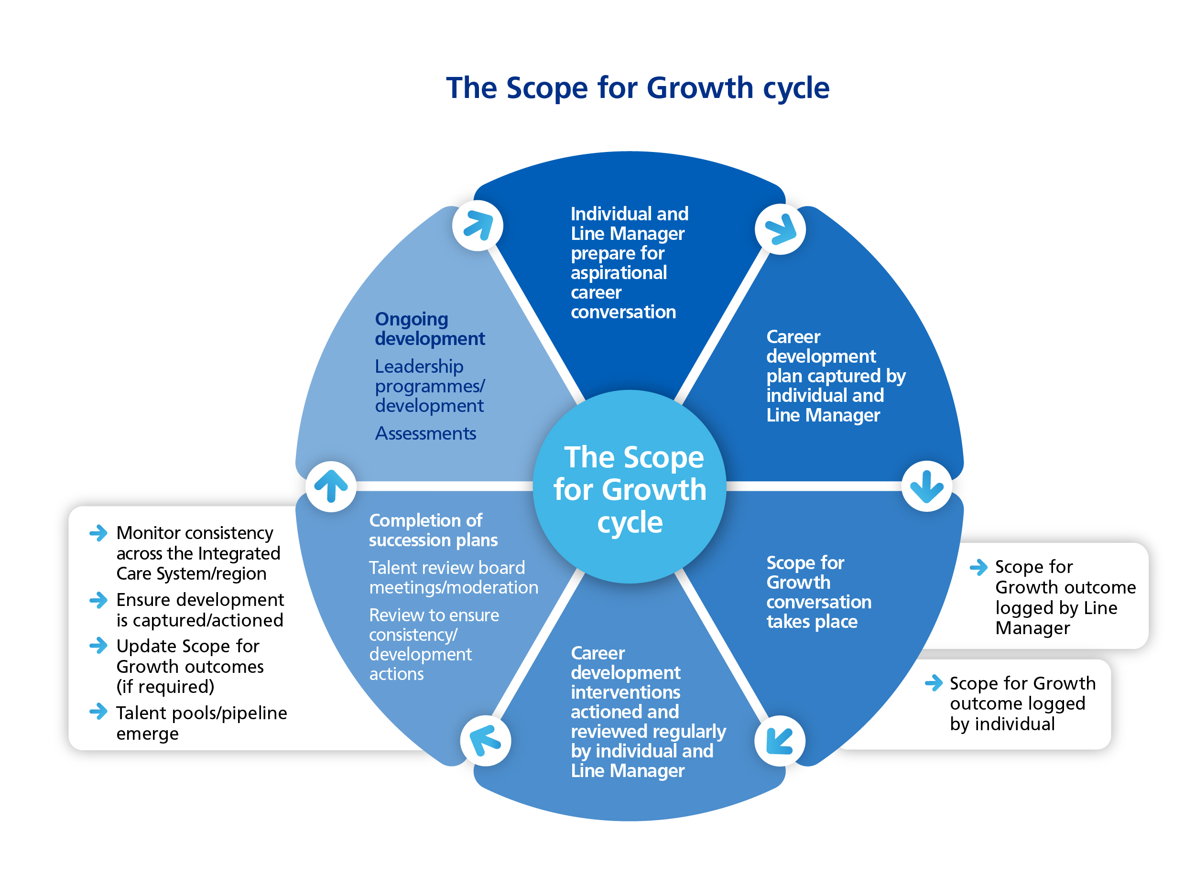

Scope for Growth – the process
Notes:
Facilitator Notes:
This is an optional slide depending on the process your organisation has chosen to use.
You can edit this to be aligned to your chosen process.

Slide 20
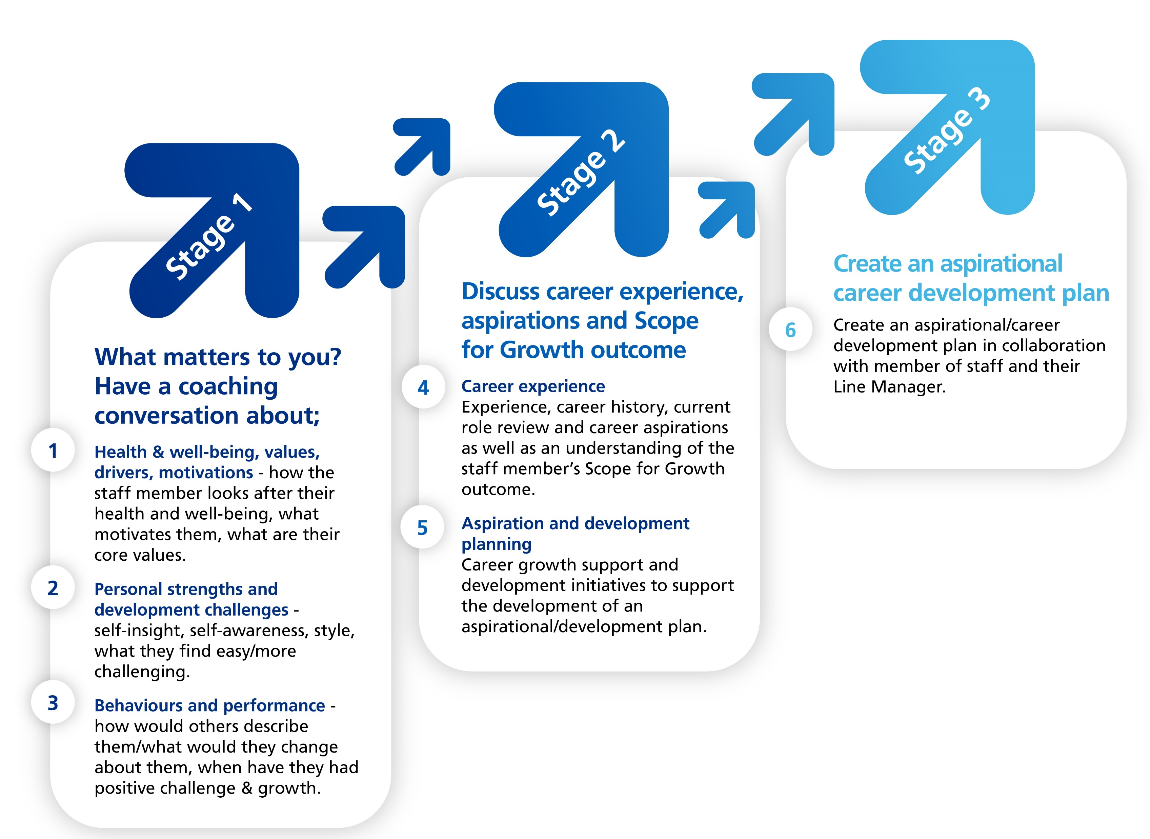
Scope for Growth – preparing for the conversation
To gain the most value from Scope for Growth career conversations it’s important that you and your team are properly prepared.
You can plan and prepare well for the conversation by:
  Reviewing the Scope for Growth overview document and guidance notes in advance of the meeting Overview Guidance
  Familiarising yourself with the Scope for Growth Model and process so you have full understanding Introduction to Scope for Growth
  Take time to reflect on your team’s strength and development areas and how these may relate to their potential career aspirations. This will help you support and tailor development opportunities to their specific needs
  Review the Scope for Growth forms and the familiarise yourself with the question and stages of the conversation approach (see illustration below)
The conversation structure:
An open discussion with around 20 minutes spent discussing topics in each of the three stages below:
Reflecting on these areas in advance of the conversation will help you and your team members develop understanding and insight into their
levels of self-management of health and well-being, behaviours and performance and core personality traits. Understanding this will help
them (and you) support them to achieve their potential
Notes:
Facilitator Script:
Before your first Scope for Growth conversation, we would advise you to take some time to prepare for the conversation. There are several resources available to you to do this, including reviewing the Information for Line Manager or Coach and the Facilitation Guide for Line Manager or Coach
It is also recommended that you take some time to reflect on your individual team member’s strengths and development areas. This will support you in having a deeper conversation and start tailoring the opportunities to the individual’s aspirations.
In terms of the structure of the conversation, this made up of three stages, with an average of 20 minutes being allocated to each stage. Therefore, it is important you have time allocated to ensure the conversation can be covered in full.
This timing is a guideline; you may find that the individual you are having a conversation with needs more or less time on different stages. For example, an individual may need longer at Stage 1, where you are discussing what matters to them and their health and wellbeing, particularly if they are dealing with in-work or out of work issues. Likewise, an individual may need more time focusing on Stage 2 to understand their own career aspirations. We would therefore recommend being flexible to support the individual’s needs.
In preparation, it is recommended to reflect on each of these stages in advance of your conversation. We will now look at these three stages in more depth.
Facilitator Note:
You may need to adapt information regarding preparation if you using localised documentation.

Slide 21
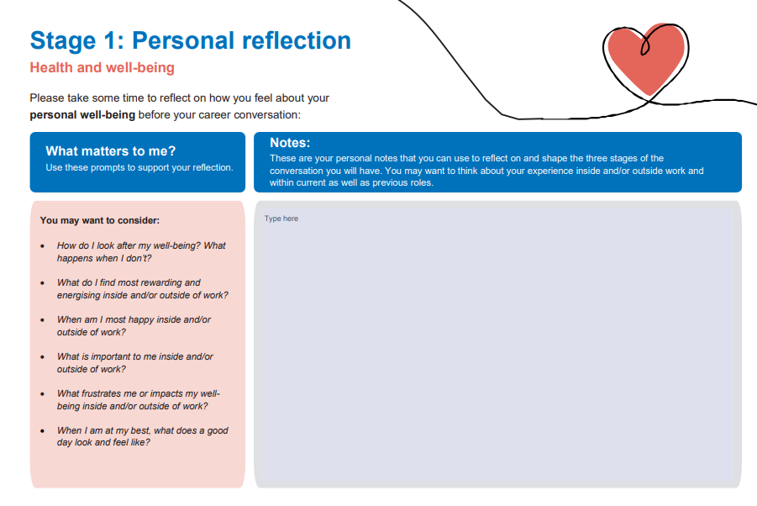
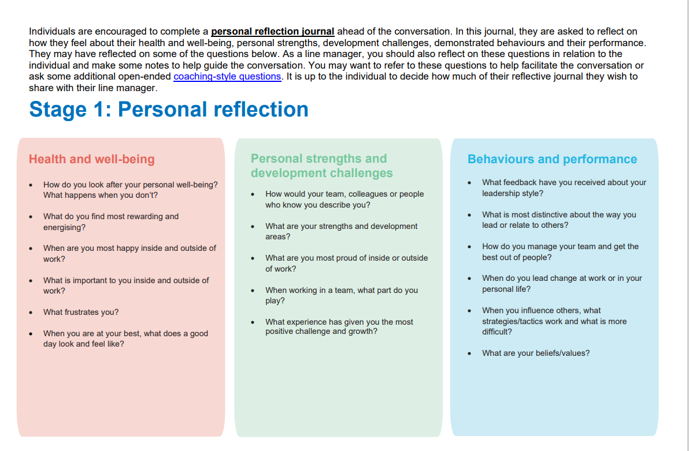
Preparation: Reflection Journal & Managers/Coach Guide
Reflection Log
Information Guide for Managers and Coaches
Coaching Questions for reflection
Notes:
Facilitator Script:
Prior to your conversation, it is recommended that you refresh your knowledge using the facilitation guide. There is also a reflection log available to for your team members. This should be reviewed in advance of the conversation to help them to reflect on the topics of the three stages. There is no expectation that an individual’s reflection will be share with anyone, this is purely for themselves to make notes on their thoughts.
Within these documents, there are coaching style questions to guide reflection. For the individual, this will support them to come to meeting with a better understanding of the issues they would like to discuss.
For a line manager/coach/manager, the information guide will help you to take a coaching approach within the discussion and support an individual’s deeper reflection.
Facilitator Note:
You may need to adapt information regarding preparation if you using localised documentation.

Slide 22
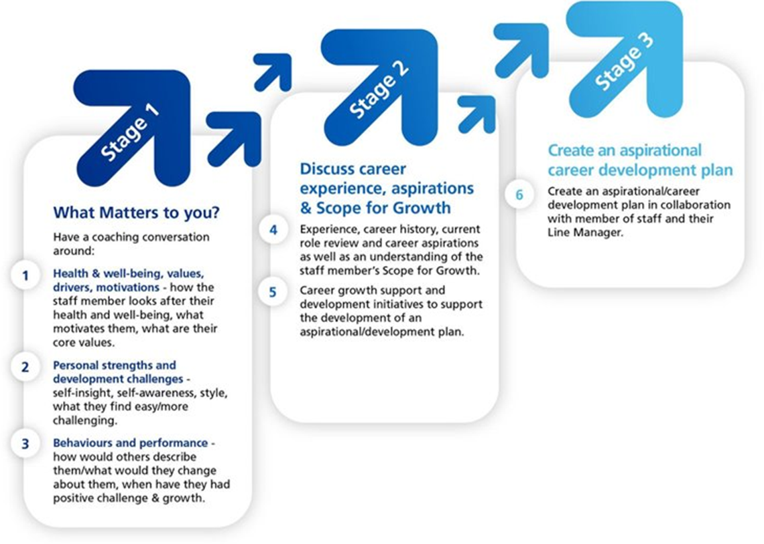
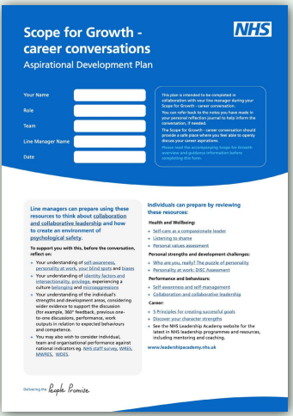
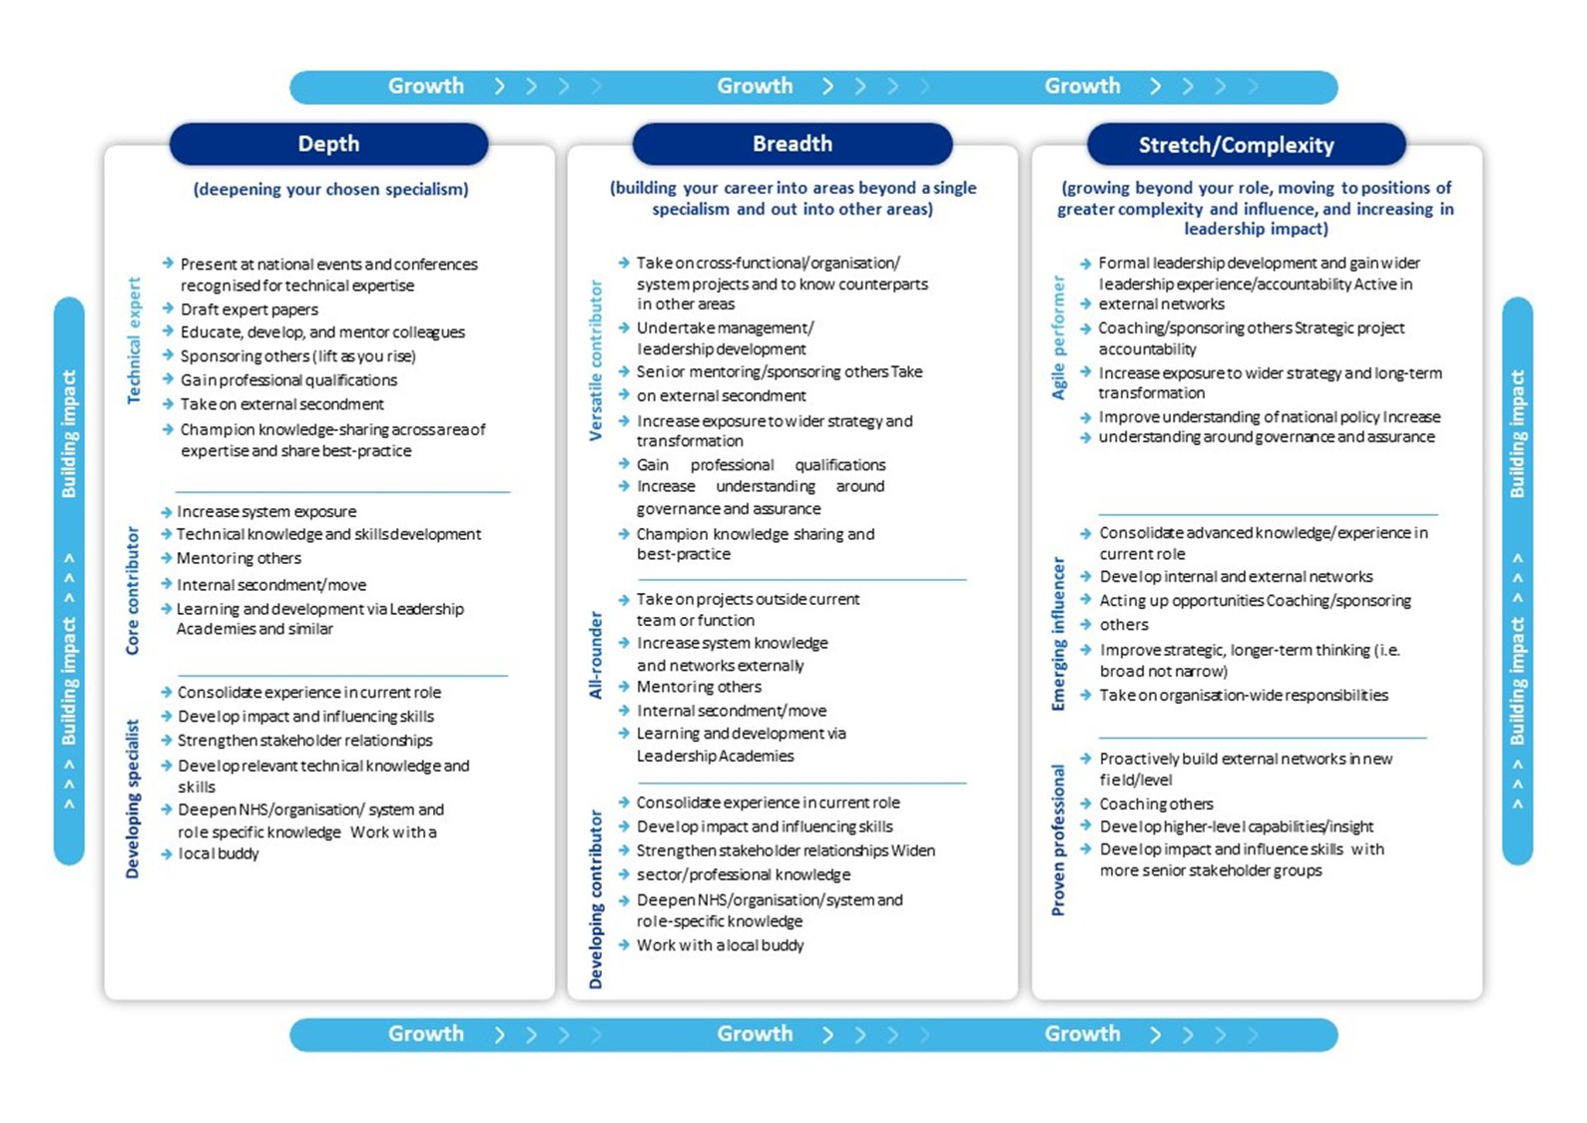
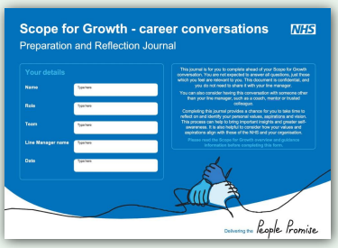
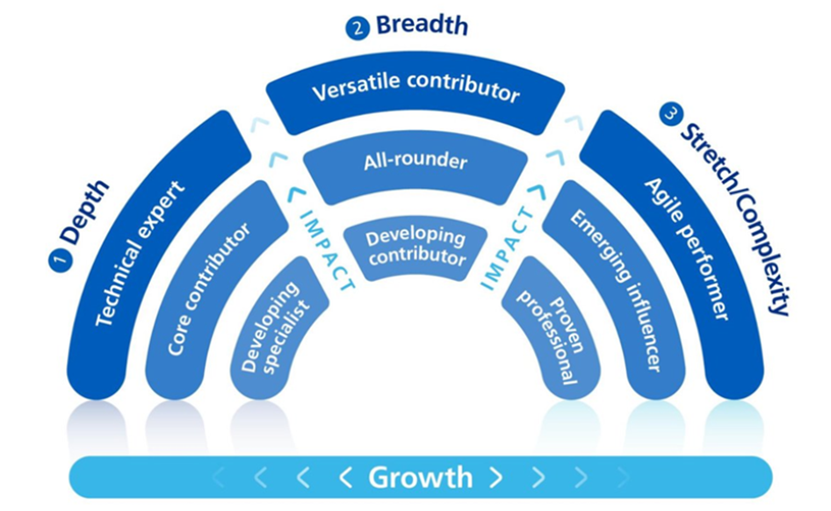
Three stages of the conversation
Development Plan & Record Outcome
Reflection Log & Facilitation Guide
Notes:
Facilitator Script:
There are three main stages to the Scope for Growth conversation, with supporting materials to aid these conversations.
Stage 1 is all about understanding ‘what matters to you?’. Here the conversation will focus on having a coaching conversation on:
Health & Wellbeing, values, drivers and motivations.
Personal strengths and development challenges. Here, you will reflect on what they find easy and what they are finding more challenging. It is important to remember that individuals often find it difficult to talk about their strengths. Your role will be to help them to discuss this and recognise where they excel. A resource which may support you where someone is struggling is ‘me at my best’ strength cards.
Behaviours and performance. Here, you will reflect on how others may perceive them and what the data around their performance tells us about their potential for the future.
Stage 2 is where the scope for growth model will come into play. We will discuss this in more depth later in the session. This stage focuses on career history and aspirations, where they currently sit on the Scope for Growth model and where they want to be in a set period of time.
Stage 3 is now about building a development plan and understanding what are the development experiences and learning needed for the individual to achieve their aspirations. This stage focuses on ‘how’ they are going to get where they want to be. To inspire the individual on the development activities, you can use the aspirational development initiatives document. Please note that this document is generic for all job roles and is not specific to a profession.
Facilitator Note:
If you have specific opportunities available to within your organisation or certain professional opportunities and career maps, please advise of these.

Slide 23
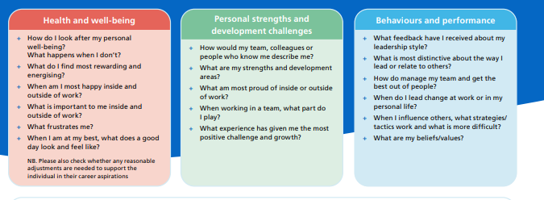
Break Out Room Exercise
In pairs, take it in turns to have a coaching conversation focusing on what matters to you
(10mins each)
Notes:
Facilitator Script:
We will now take some time to practice the stage one part of the conversation. This will give you an opportunity to practice using coaching style questions in safe space and to also understand how it feels to have the conversation from an individual’s perspective.
Working in pairs, take 10 mins each to have a conversation around ‘what matters to you’. Using the Aspirational Development Plan document to guide some of the questions you may ask. Don’t worry if you don’t cover all three of the items within Stage 1, work through the most important to you.
Facilitator Notes:
If online, use break out rooms.
If in the room together, allow pairs to spread out as much as possible in order to have a good quality conversation within a safe space.
Once the 20 minutes have been completed, bring the individuals back into the room and have a short group discussion on how that felt for them or if they have any insights they would like to share.

Slide 24
Break time
Notes:
Facilitator Notes:
It is recommended to have a 10-15 minute break depending on timing.

Slide 25
The Scope for Growth Model
Notes:
Facilitator Script:
We will now take you through the Scope for Growth model which forms the stage 2 part of the conversation

Slide 26
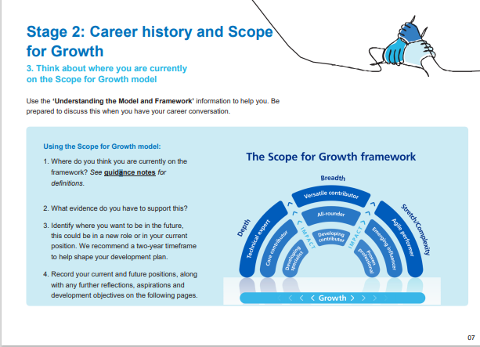
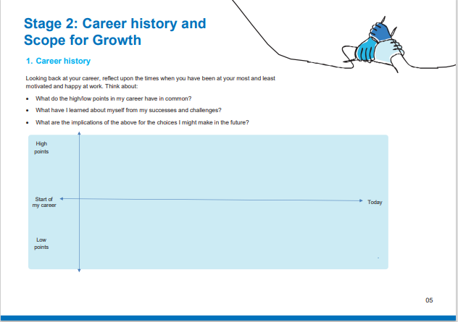
Individual Reflection
S4G Model reflection
Plot career journey
Notes:
Facilitator Script:
As part of the individual reflection document, individuals will have the opportunity to reflect on their career history, including the high and low points and start to reflect on where they sit on the scope for growth model now and where they would like to be in the future. It will also introduce them to the Scope for Growth model and its language. By including this in the individual reflection, they can begin to reflect on where they will sit within the model in advance of your conversation.

Slide 27
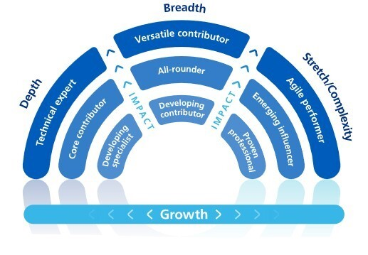
Model component 1: Ambition Categories
The Scope for Growth model has three 'ambition categories':
Depth – deepening our people's expertise in their chosen specialism
Breadth – building out our people's careers into other areas / beyond a single specialism
Stretch/complexity - growing beyond and surpassing their current role and surpassing their current roles expectations. They have a desire to move to positions of greater complexity and influence and increase leadership scale and capability.
Definitions of the segments are introduced in more detail when we look at how to use the model.
Inclusion point: There is no in-built hierarchy to the ambition categories.
One is not perceived to be better than another. All should be considered equal.
Notes:
Facilitator Script:
The Scope for Growth model has ‘3 ambition categories’, depth, breadth and stretch/complexity
For Depth, this is focusing on deepening our people’s expertise in their chosen specialism. For example, someone may be looking to stay within their current role, but recognises that they may have some knowledge gaps and want to be the best they can possibly be within that role.
For Breadth, this focuses on building out of people’s careers into other areas and beyond a single specialism. For example, staying within the same directorate, but focusing on different projects or types of work.
For stretch and complexity, this is supporting individuals to go beyond their current role and role expectations. This is where someone aspires to move into a role with a greater degree of complexity, for example a more strategic role, and/or where they are in a leadership position. This may also be where someone is looking for a complete career change e.g. moving from clinical to non-clinical.
It is important to note that there is no in-built hierarchy to these ambition categories and they are all considered as equal or done sequentially.

Slide 28
Model component 2: Axes - Impact & Growth
The Scope for Growth Model has two axes - Impact and Growth.
Impact refers to an individual’s underlying capability, along with their contribution to their team, organisation, and wider stakeholders. Impact is both what individuals do and how they do it. Performance in role will influence this axis.
Growth refers to an individual’s personal ambition for growth across the three elements of depth, breadth and stretch/complexity.
Inclusion point: Another critical factor​ for consideration is individual aspiration. People may have the potential to grow​ or have greater impact but if their aspiration is to remain in the​ technical area of expertise or specialism, consolidate skills and​ knowledge, or simply do not want to consider a career move at​ that time, then this will be appreciated and valued.​
Notes:
Facilitator Script:
In addition to the ambition categories, the axes within the model reflect an individual Impact and Growth.
The impact axis refers to an individual’s underlying capabilities and their contributions to the team, organisation and wider stakeholders. Impact is about what individuals do and how they do it. This element will be influenced by the individual performance in their current role. An example of this is where someone is new to role and/or at the start of their career. Here, they may identify themselves as in the ‘Depth’ ambition category, with their degree of impact suggesting that they are currently a ‘Developing Specialist’. Their ambition may therefore to be a ‘core contributor’ within 6-12months, where their impact has increased.
Growth refers to an individual’s personal ambition for moving across the three ambitions and therefore how much they want to move across them within a certain time frame in order to achieve their goals.
As an inclusion point, it is important to consider that this in individual’s personal aspiration and whilst people may have the potential to grow outside of their current role or have a greater degree of impact, they may have the aspiration to remain within their current role at that time. It is important that we consider what we have heard around their health and wellbeing here.

Slide 29
AHP Support Worker Example!
4. Orthotics & ED experience
5. Apprentice: Orthotics & Prosthetics
2. Workplace NVQ’s
1. Bin waste porter
3. Degree for AHP SW
“To start the journey of becoming a AHP SW is the hardest bit, but once you’re in, you’re in and there is then no ceiling to career growth”
Notes:
Facilitator Script:
To bring this to life, we have an example to showcase how an AHP support worker’s career journey has moved around the 3 ambition categories.
Our example started their career as a bin waste porter within a hospital and would have been considered as a ‘technical expert’ in terms of their impact within this role. However, they decided they wanted to ‘stretch’ themselves outside of their role and wanted to do something different. To support this, they did several ‘work-based’ NVQs to see what they liked – moving them into the strength/complexity ambition category.
Once this was completed, they decided to concentrate on a specific area of work and started study a degree to become an AHP support worker, placing themselves within the Depth ambition category as a ‘Developing Specialist’ as they are newly focusing on a specific discipline.
Whilst studying, they wanted to gain a varied experience, moving into the Breadth category and began working across Orthotics and & in ED to see which areas they were most suited to. They are now an Apprentice in Orthotics and prosthetics, remaining in the Breadth category whilst deciding where they may want to specialise.
This demonstrates how an individual can continuously move across the ambition categories and that career is not always linear
Facilitator Note:
This a template slide, depending on your audience, you may want to use another example for a different professional background. Use an example which is most relevant to your organisation/the audience.

Slide 30



Finding my Scope for Growth position
Use the chart below to identify which ambition category you are currently in and then continue to identify and read your current level of impact.
Next, think about where you want to be in the next 12-24 months. Do you want to stay in your current ambition category and level of impact? Or move into a different category - if so, select another ambition category and identify and read the aspired level of impact. Continue until you have a clear idea of where you are now in terms of your Scope for Growth position and where you want to be in the next 12-24 months. Discuss
your Scope for Growth profile with your line manager, coach or trusted colleague as part of your career conversation.
Start Here
Do I want to stay in my current role/ discipline/function and continue to grow in this field/profession?
Do I want to stay in my current discipline but broaden my role/knowledge/expertise into other areas or functions?
Do I want to move from my current role into another role, perhaps one with greater complexity and/or leadership impact?
No
No
Yes
Yes
Yes
I am in Depth
I am in Breadth
I am in Stretch/ Complexity
Depending on whether you agree ‘yes’ to Depth or Breadth or Stretch, click the ambition box to find the matching description.
Notes:
Facilitator Script:
To support individuals to find where they currently sit and where they want to want to be in the future, they can use the flow charts within the ‘Finding my place on the framework’ guidance, working through questions to support reflection.
This flow chart supports individuals to find which overall ambition category they sit within.

Slide 31


Finding my role in Depth
Restart
Continue Here
I am in Depth
Do I want to advance in this field or develop my potential in this area?
Do I want to stay in this role or move to similar role in the team?
Am I considering developing and broadening my experience?
No
No
Yes
Yes
Yes
I am/aspire to be a technical expert
I am/aspire to be a core contributor
I am/aspire to be
a developing specialist
Decide if you agree ‘yes’ to technical expert or core contributor or developing contributor. Then review the associated role description in more detail on the Scope for Growth Framework to confirm your place.
Notes:
Facilitator Script:
Here the flow chart for Depth. This flow chart will help determine where an individual is and wants to be in terms of their impact levels
Facilitator Note:
If needed, you can work through the flow chart

Slide 32
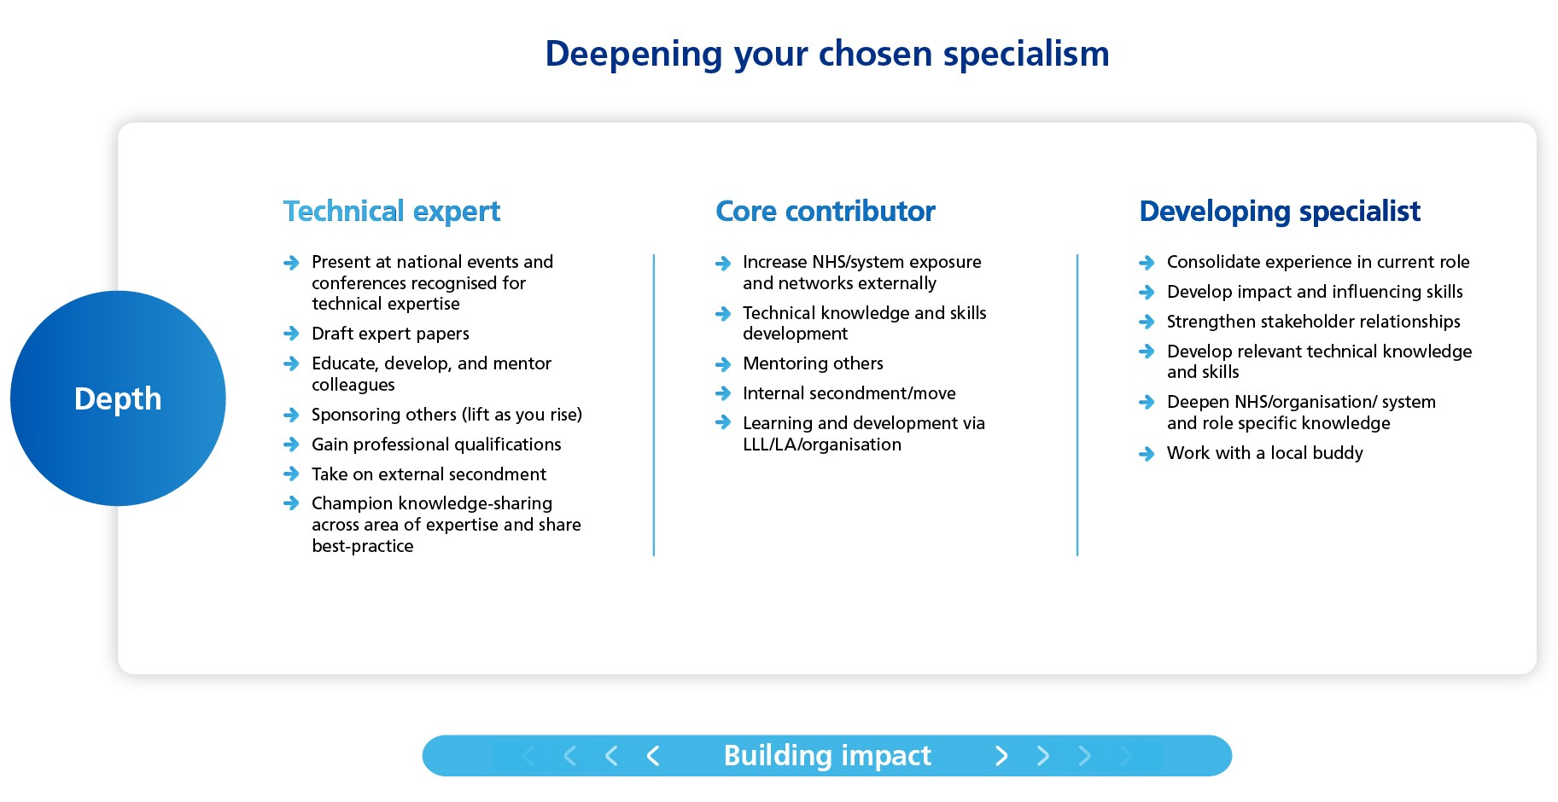
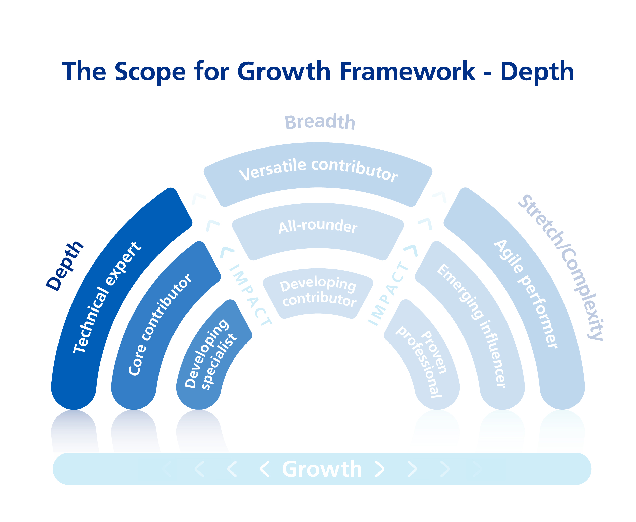
Scope for Growth Definitions - Depth
Depth is about expanding our people’s expertise in their chosen specialism
Notes:
Facilitator Script:
In addition to the flow charts, once you have been able to determine which ambition and impact category the individual sits within, you can also use the information shown above for examples of the type of work, experience and/or knowledge an individual would have if they sit within each impact category. This can be used to understand your ambitions as well. For example, you may have determined that you are currently a core contributor now, but want to remain in Depth and become a technical expert. The examples above will give an indication of the sort of work, experience and/or knowledge that would in involved in becoming that Technical Expert.
Please note that these are generic examples so that they can be used for all professions. There may be specific examples for your profession.

Slide 33
Finding my role in Breadth
Restart
Continue Here
I am in Breadth
Do I wish to move into significantly larger roles within a similar function or discipline?
Do I have the desire to broaden my experience into other areas within my current expertise?
Am I new in my current role and / or still developing my capability and impact?
No
No
Yes
Yes
Yes
I am a versatile contributor
I am an all rounder
I am a developing expert
Decide if you agree ‘yes’ to versatile contributor or all rounder or developing expert. Then review the associated role description in more detail on the Scope for Growth Framework to confirm your place.
Notes:
Facilitator Note:
This slide is hidden.
This is the flow chart for Breadth, you go through this if necessary.

Slide 34
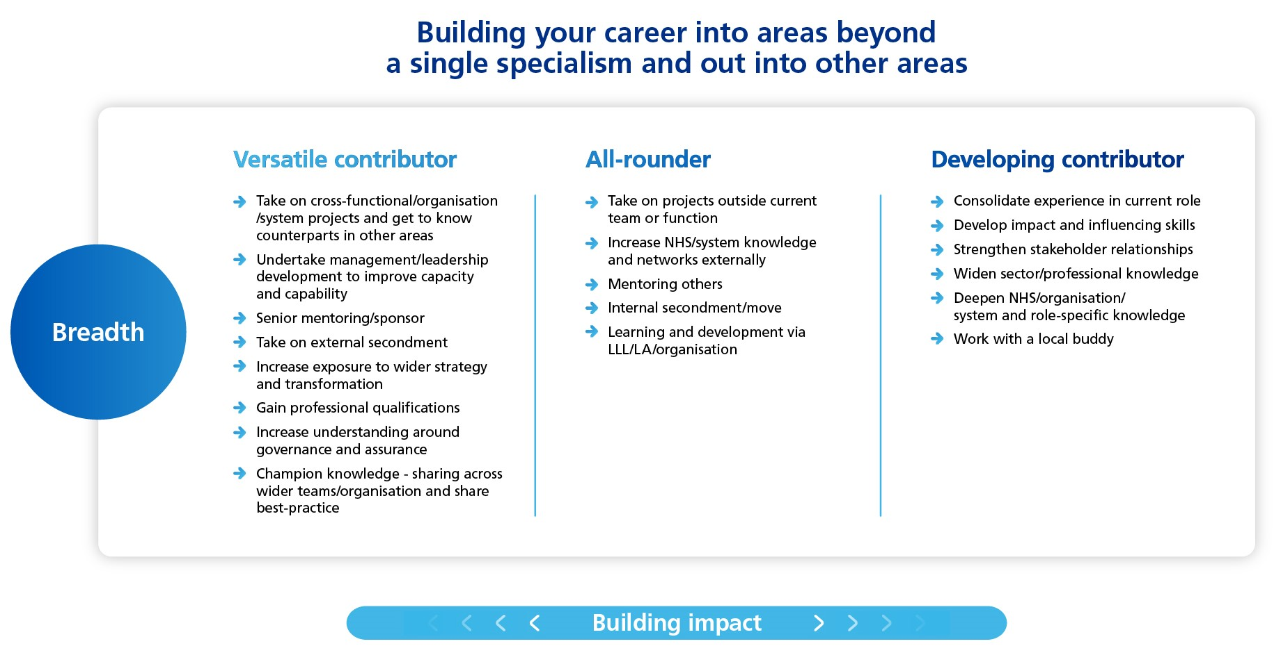
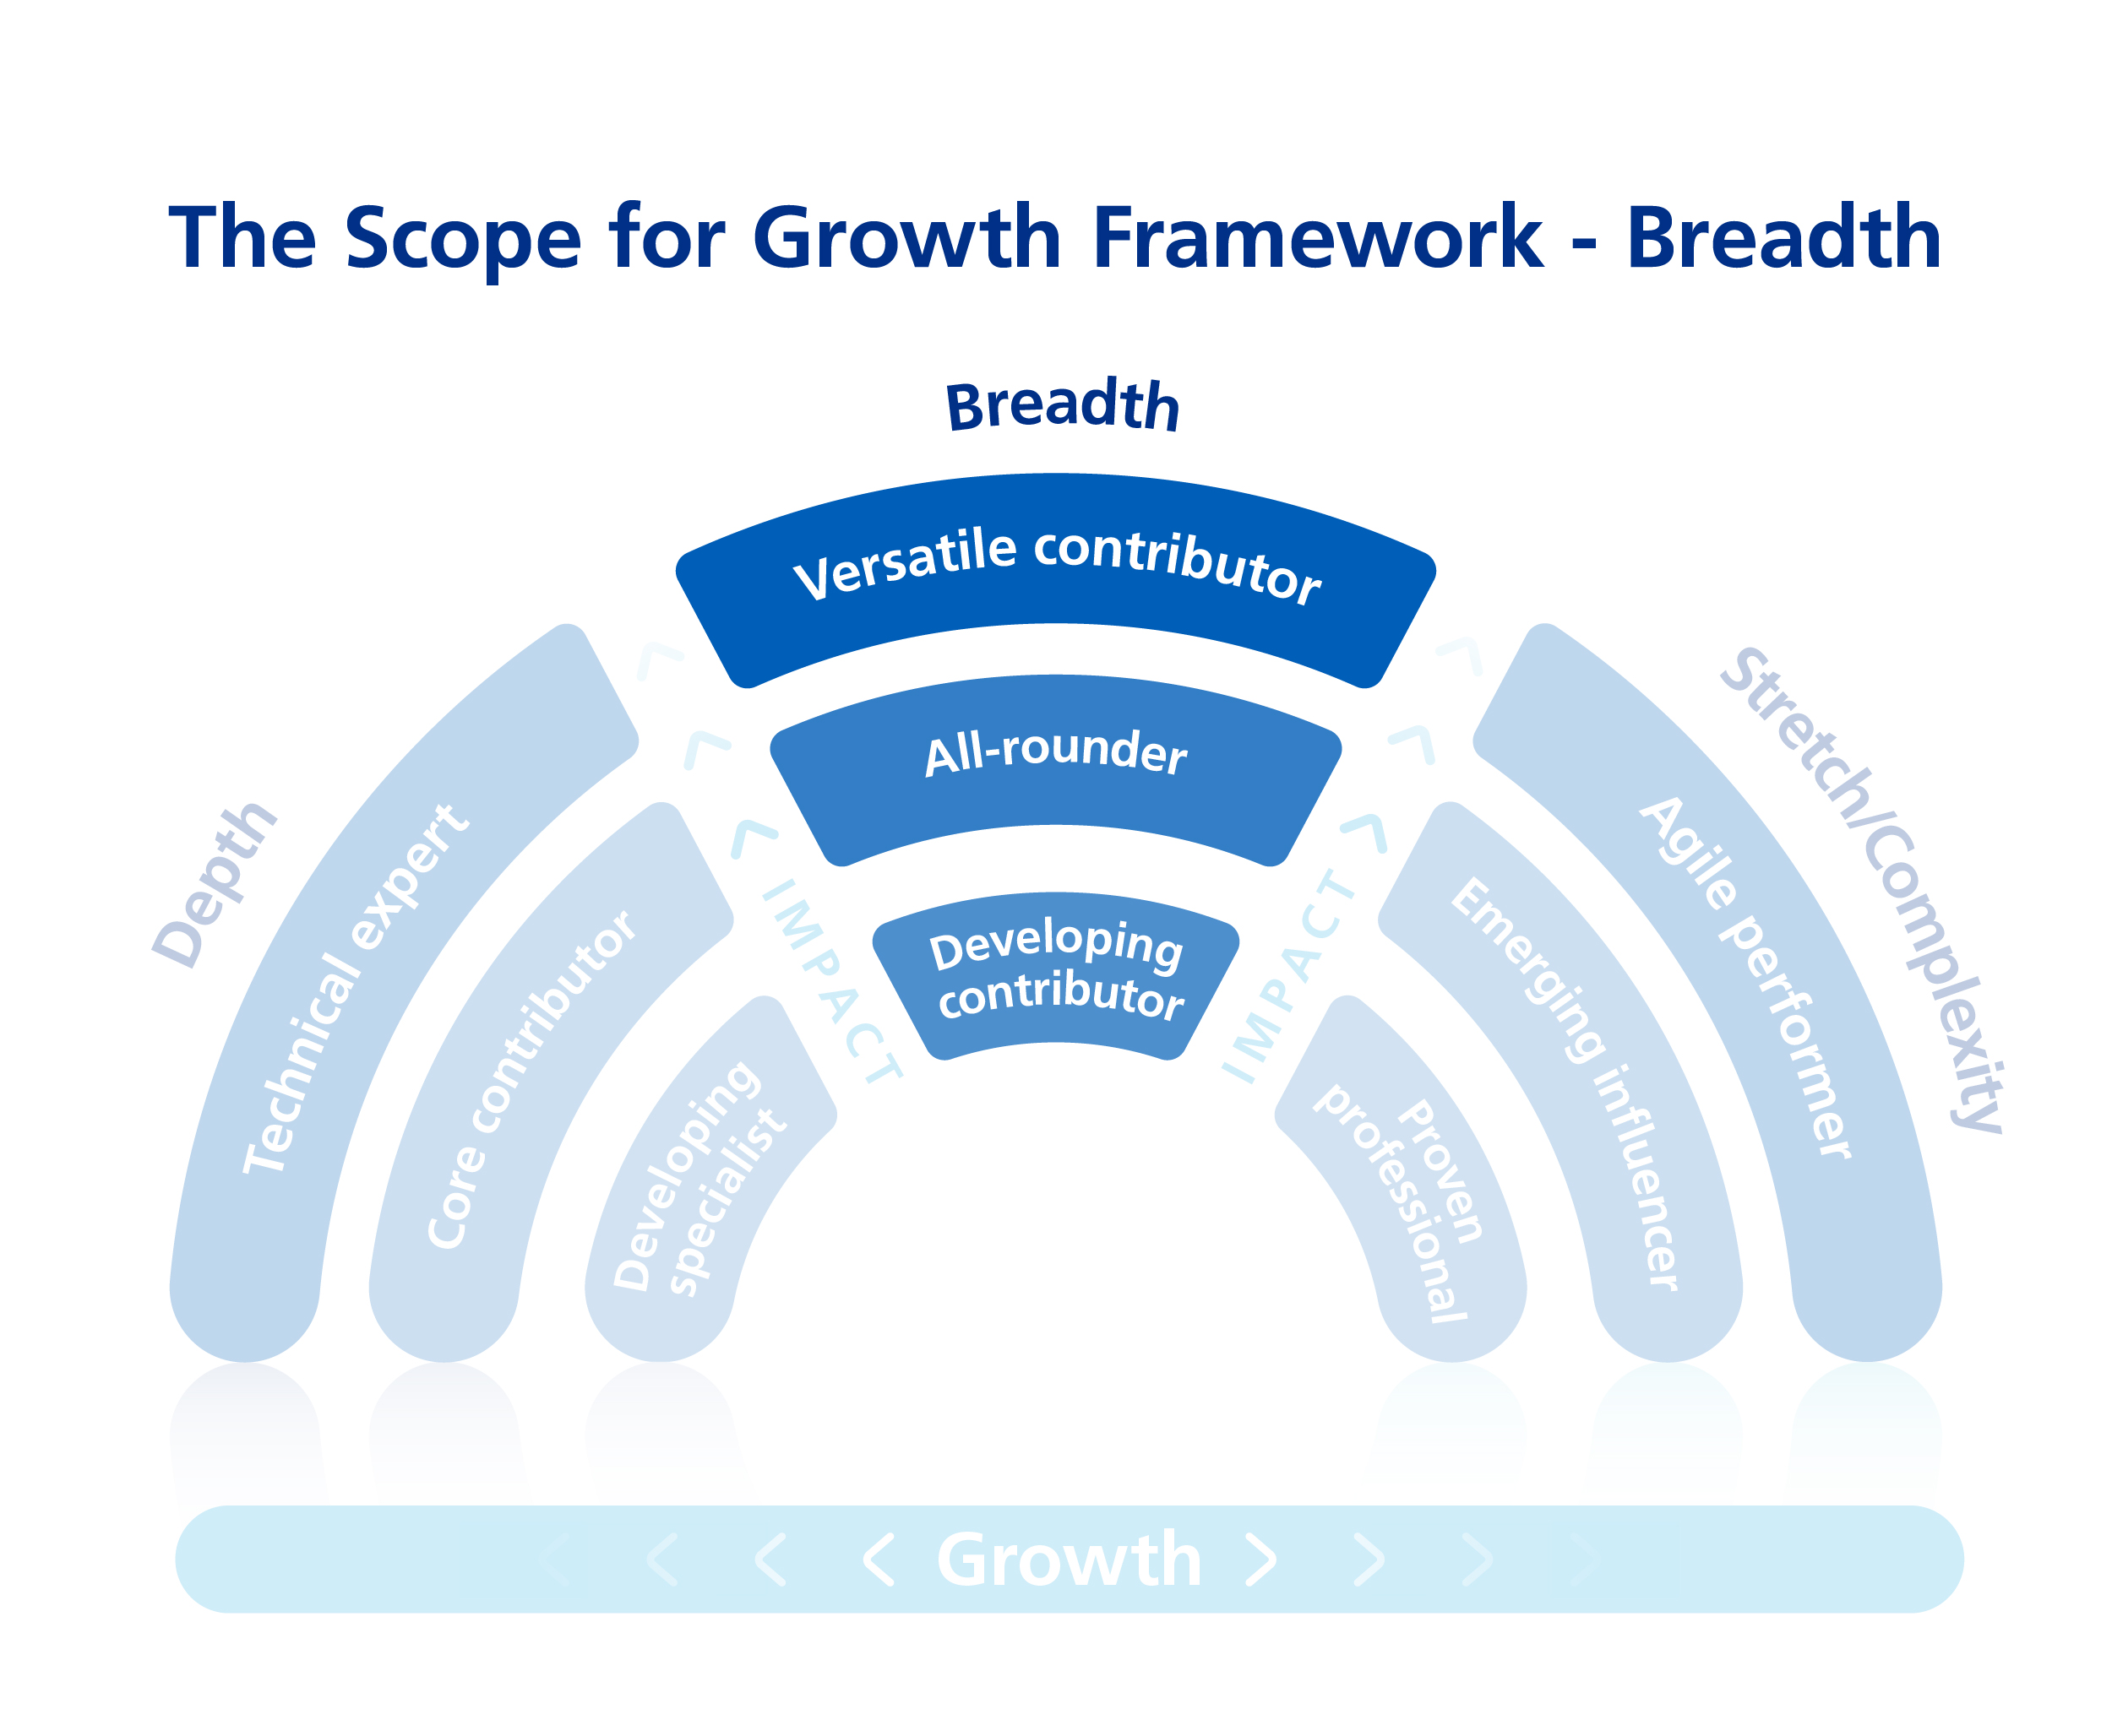
Scope for Growth Definitions - Breadth
Breadth is about building our people’s careers beyond a single specialism
Notes:
Facilitator Note:
This slide is hidden.
This is the definition for Breadth, you go through this if necessary.

Slide 35

Finding my role in Stretch/Complexity
Restart
Continue Here
I am in Stretch/ Complexity
Do I have transferrable skills to move into larger or more complex/bigger leadership role?
Do I wish to develop in generalist areas with a degree of ambiguity outside my current role?
Do I wish to move on to a more stretching role?
No
No
Yes
Yes
Yes
I am an agile performer
I am an emerging influencer
I am a proven professional
Decide if you agree ‘yes’ to versatile contributor or all rounder or developing expert. Then review the associated role description in more detail on the Scope for Growth Model to confirm your place on the model.
Record where you have placed yourself on the Scope for Growth model in your reflection journal and discuss this with your line manager during your career conversation.
Notes:
Facilitator Note:
This slide is hidden.
This is the flow chart for Stretch/Complexity, you go through this if necessary.

Slide 36
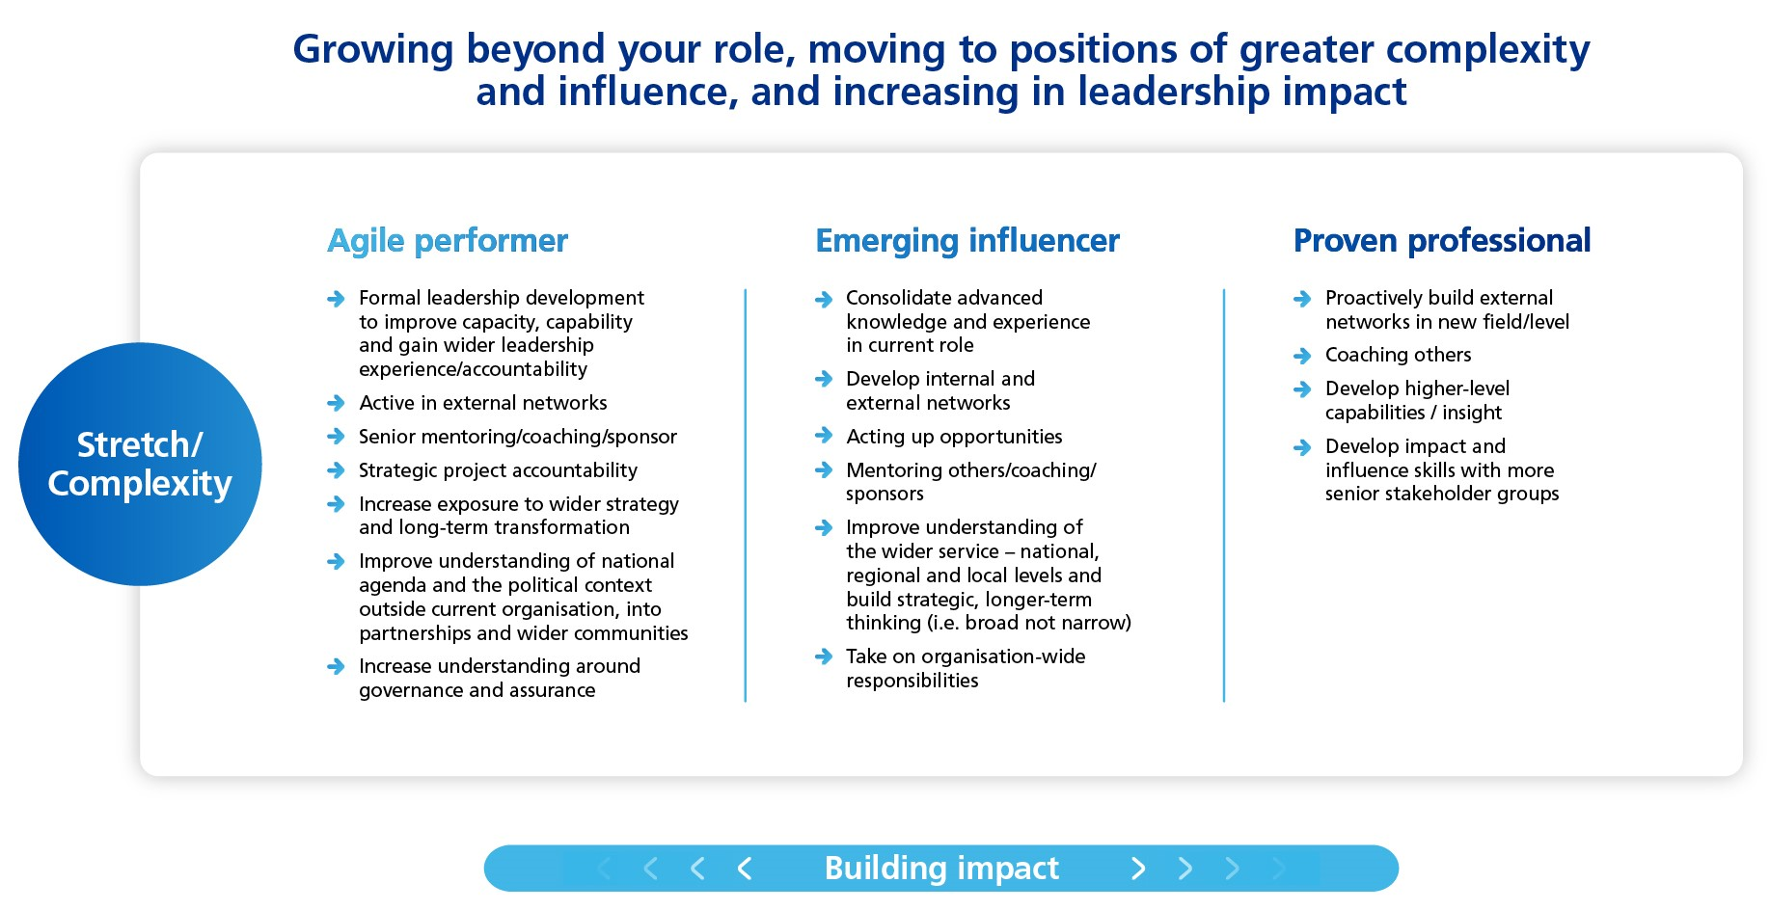
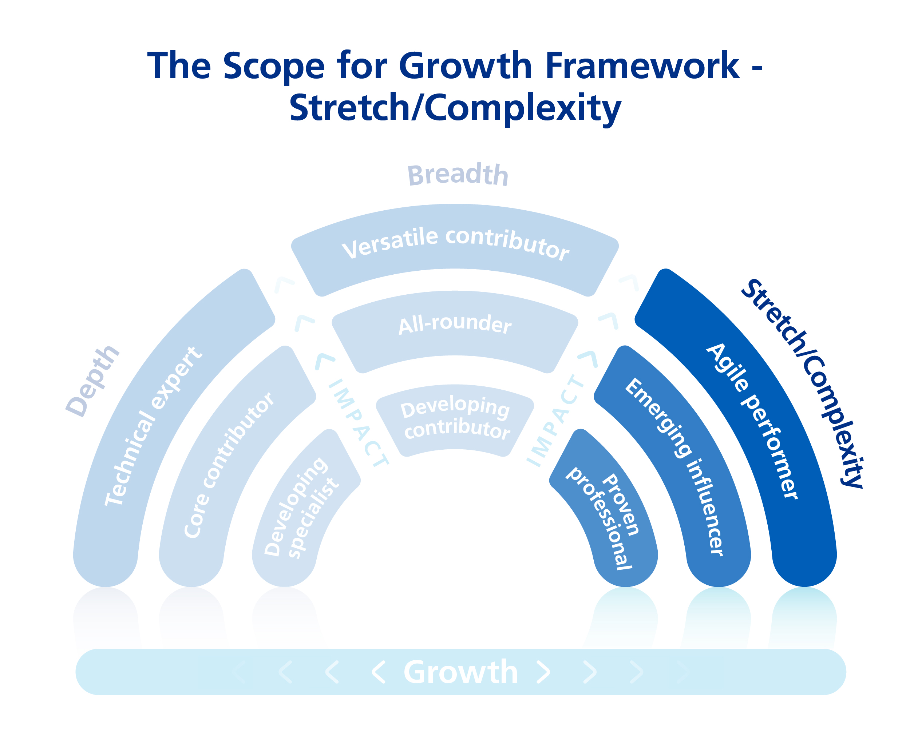
Scope for Growth Definitions – Stretch/Complexity
Notes:
Facilitator Note:
This slide is hidden.
This is the definition for Stretch/Complexity, you go through this if necessary.

Slide 37
Using the model: Summary
Identify current position - Individual and line manager agree the individual’s current position in one of the model segments (see next slides). What evidence is there to support this?
Identify aspirational position - Identify where the individual wants to move to in the future and how they will do this to progress their careers. A two-year timeframe is recommended to help shape their development plans.
Record current position - Support the individual to record their current position on the model on the conversation record along with further reflections, aspirations and the appropriate development interventions (explored in next section).
Notes:
Facilitator Script:
As a summary, when working through the model, you will guide the individual to identify their current position, discussing the evidence that supports this.
Following this, you will then discuss their aspirational position. It is recommended to identify this within a two-year timeframe. However, this may depend on the individual’s aspirations and whether they need to move more around the ambition categories to achieve their career goals.
Once this has been completed, record their position.
Facilitator Note:
Enter information regarding your recording processes.

Slide 38

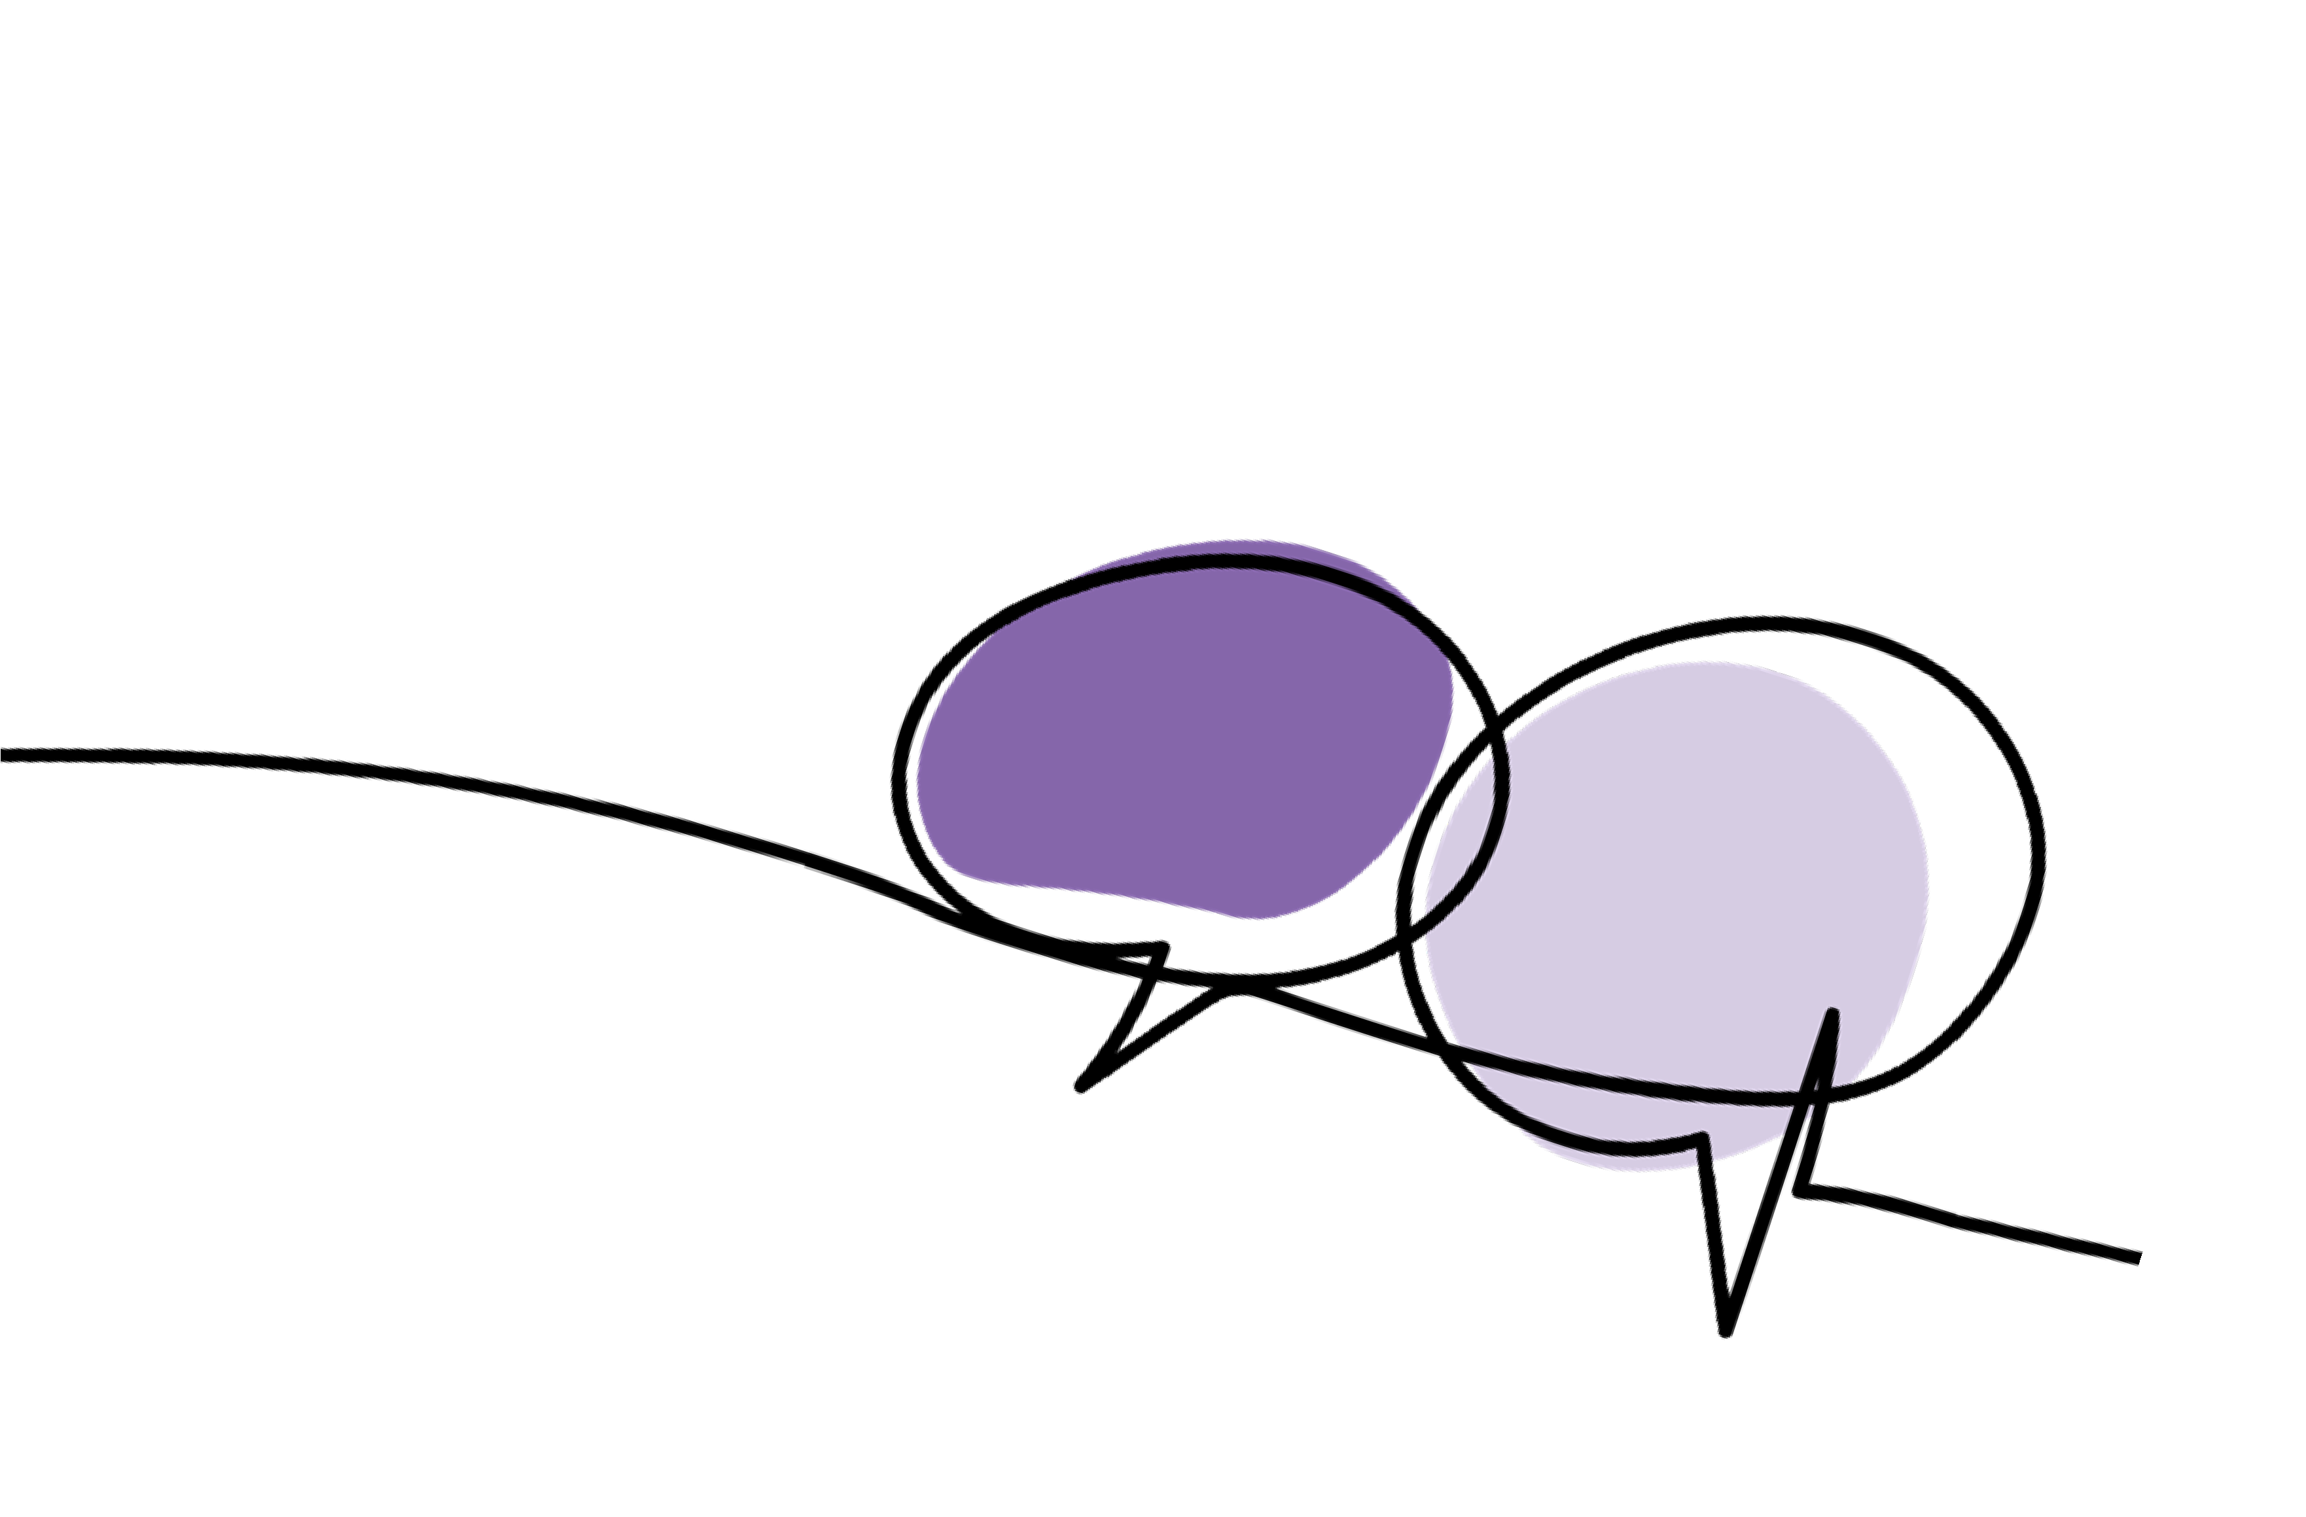


Your questions … answered
Q. Can I be in more than one ambition category?
Q. What if I am happy in my current role and want to stay where I am?
A. You may identify with more than one description.
It is recommended that you select a preference
to prioritise as this will help you to create a focussed and achievable career development plan. You may have shorter time frames than 12-24 months and can revisit your plan and have more regular talent conversations.
A. That is absolutely fine. If you are happy in your current role, that will be respected and appreciated. You are in the driving seat of your career. The Scope for Growth framework is designed to help you create a development plan that meets your needs.
Q. Do I have to progress across each ambition category in a particular order?
A. No. The framework is flexible. Where you position yourself will be decided by your personal reflection and career conversations.
Notes:
Facilitator Script:
Here are some answers to some commonly asked questions.
For question 1, ‘can I be in more than one ambition category?’, you may identify with more than one description, the recommendation is to work through a preference and prioritise this to create a focused plan. It might be worth considering shorter time-frames and come back to the conversation more often
For question 2, ‘what if I am happy in my current role and want to stay where I am?’ as we have discussed already, where someone shares this, this should be respected and appreciated. It may be worth talking through any development initiatives there might be to support them in their current role.
For question 3, ‘do I have to progress across each ambition category in particular order?’, no, as we saw in the AHP example, there is no hierarchy or order to the framework, it can be flexible to your personal reflections.
Facilitator Note:
Add any FAQ’s which may be relevant to your organisation

Slide 39
The Development Initiatives
Notes:
Facilitator Script:
We will now go through the final stage of the Scope for Growth conversation.

Slide 40
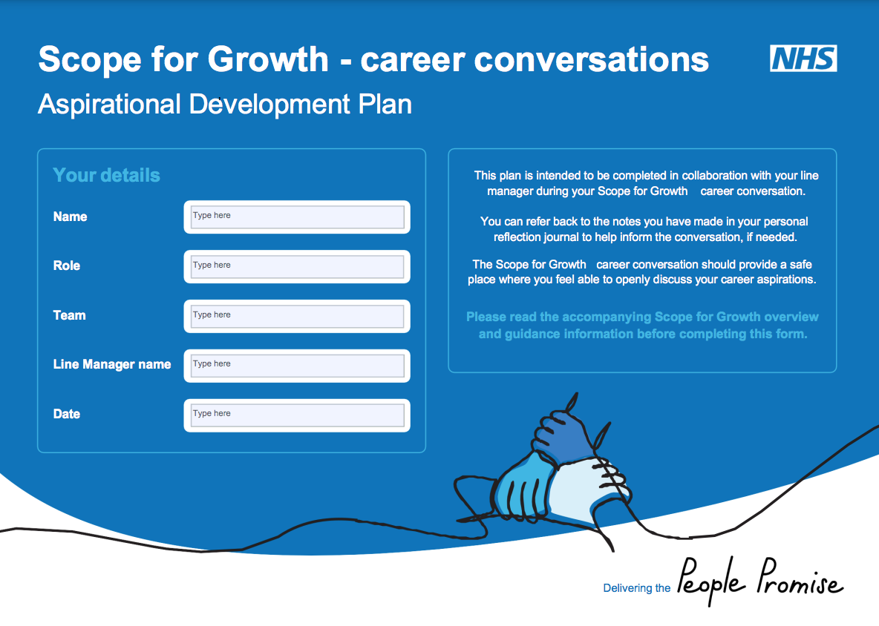
Aspirational Development Plan
Stage 1 - Space to capture reflections
Stage 2 – question prompts and space to capture responses
Stage 3 – priorities for development
Notes:
Facilitator Script:
During this part of the conversation, you will make notes within the Aspirational Development Plan document, with coaching questions within the guidance document to support the conversation.
Now that you have identified where the individual currently is and where they want to be, this part of the conversation is about how they get there. This is where you will support the individual to identify the development activities that will help them achieve their career aspirations.

Slide 41
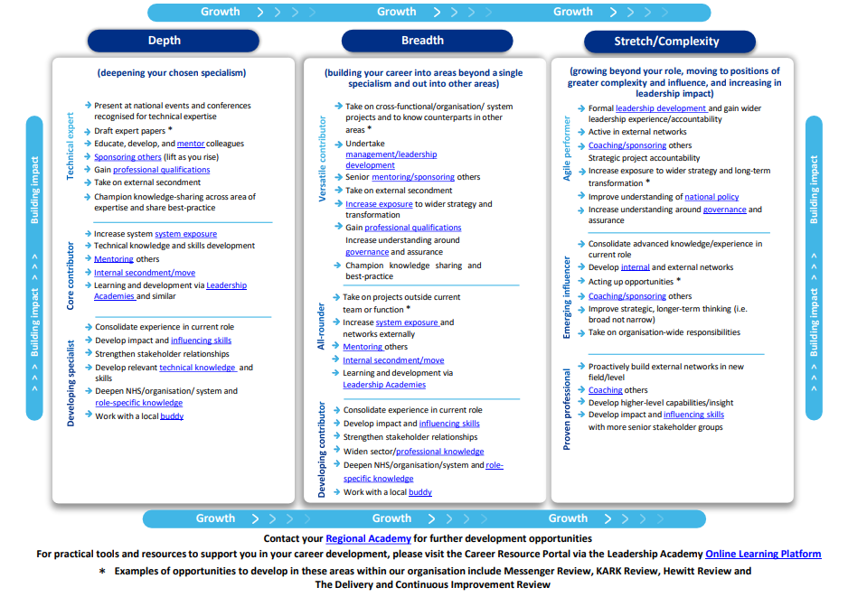
Suggested development initiatives
Suggestions to support practical career development initiatives and structured interventions to help team members develop their careers regardless of their individual aspirations. Understanding your team’s aspirations is essential to recognising the required development activities to help shape their career journeys.
Notes:
Facilitator Script:
To support the identification of development initiatives, you should use the Aspirational Development initiatives document. This document should be used as inspiration and gives examples of the types of experiences you can do based on your ambition category.
As before, these items are generic for any professions, so there may be different activities for your specific profession.
Within this, you will also find direct links to training and development opportunities, including national programmes.
Facilitator Note:
If you have a bespoke document, please add this here.

Slide 42
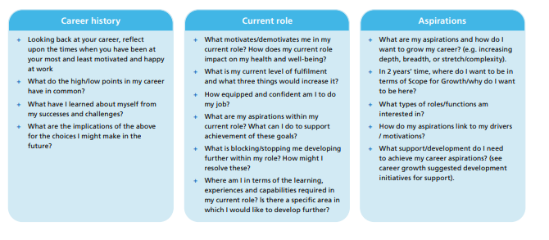
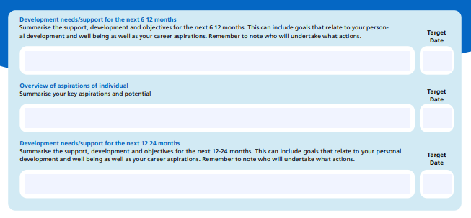
Break Out Room Exercise
As individuals take a couple of minutes to think about your own position on the framework, now and/or in the next 12-24 months
In pairs – take it in turns to have a coaching conversation focusing on stages 2 & 3 (15-20 mins each)
Notes:
Facilitator Script:
We will now take some time to practice the stage two and three part of the conversation. This will give you an opportunity to practice using coaching style questions and also understand how it feels to have the conversation from an individual’s perspective.
Working in pairs, take 15-20 mins each to have a conversation around the career aspirations and Scope for Growth model. Using the ‘Finding my place on the framework’ guidance and Aspirational Development Plan document, discuss where you currently are within the model and where you would like to be within a given timeframe e.g. 2 years. Once you have identified where you are on the S4G model, move to stage three and start to plan development initiatives.
Facilitator Notes:
If online, use break out rooms.
If in the room together, allow pairs to spread out as much as possible in order to have a good quality conversation.
It is recommended that you use the same pairings as the stage 1 activity.
Once the 30-40 minutes have been completed, bring the individuals back into the room and have a short group discussion on how that felt for them or if they have any insights they would like to share.

Slide 43
Any questions?
Feedback – we would really value your thoughts!
Notes:
Facilitator Script:
This now brings us to the end of the Scope for Growth career conversations. We wanted to provide an opportunity for any questions you may have?
Thank you very much for your participation in today’s training. We would really value hearing what you thought of today’s event
We will now showcase some additional resources available to you..
Facilitator Note:
Insert links/QR code to gather feedback from the session

Slide 44

Film - Holding the conversation
Notes:
Facilitator Script:
To support you in preparation for your Scope for Growth conversation, we will share this video of a Scope for Growth conversation taking place. This will give you a reference point on how to conduct a conversation and should help to build your confidence. This video is just under 30 mins
Facilitator Note:
Please share this with your line managers as a reference point and for them to prepare before holding their first Scope for Growth conversation

Slide 45
Career Stories
“Your biggest challenge and your biggest obstacle to development is yourself and your belief in yourself. So remember that if others believe in you, then it's highly likely that you are the right individual for that role and take a risk and go for it.”
Talent Career Stories - Interview with Sarah James (youtube.com)
Please click here to view and learn more about these inspirational career stories from across the NHS.
Notes:
Facilitator Script:
Hearing from others about their career journeys can be a great inspiration when considering our own choices. Here, senior leaders share their own personal career journeys. Please use these as motivation for your own career and share with individuals you are having Scope for Growth conversations with to support motivation.
Facilitator Note:
Included on this slide is a video from Sarah James (East of England) due to the discussion around diversity of careers.
Please note there are long and short version of each interview. If you plan to play a video during the training, we would recommend playing a short video and following up with long videos.
South West
Emma Wood - Director of People, University Hospitals Bristol and Weston FT
Short Video - Talent Career Stories - Interview with Emma Wood – YouTube
Long Video - Full length interview with Emma Wood - Career stories – YouTube
Vinay Takwale - Medical Director, NHS England and NHS Improvement South West Region and Consultant Orthopaedic Surgeon, NHS England SW
Short video - Talent Career Stories - Interview with Vinay Takwale – YouTube
Long Video - Full length interview with Vinay Takwale - Career stories - YouTube
Midlands
Bina Kotecha - Associate Director of Systems Leadership and Organisational Development, University Hospitals of Leicester FT
Short Video - https://www.youtube.com/watch?v=yUx9cQGoqnU&list=PLKWZBthKeVZ7rvewjVE0iCULS-NWTGPy3&index=1
Long video - Full length interview with Bina Kotecha - Career stories – YouTube
Danielle Oum – Chair, Birmingham & Solihull Mental Health FT
Short video - https://www.youtube.com/watch?v=fJh4-WEXzGg&list=PLKWZBthKeVZ7rvewjVE0iCULS-NWTGPy3&index=5
Long video - https://www.youtube.com/watch?v=nqeELQaqVEI&list=PLKWZBthKeVZ7rvewjVE0iCULS-NWTGPy3&index=11
East of England
Sarah James - Hospital Director - Cancer Division, East & North Hertfordshire FT
Short video - Talent Career Stories - Interview with Sarah James – YouTube
Long Video - Full length interview with Sarah James - Career stories – YouTube
London
Colbert Ncube - Director of Transformation & Commissioning, SW London ICB
Short Video - Talent Career Stories - Interview with Colbert Ncube – YouTube
Long Video - Full length interview with Colbert Ncube - Career stories – YouTube
North East & Yorkshire
Therese Patten - Chief Executive, Bradford and Care NHS FT
Short video - Talent Career Stories - Interview with Therese Patten – YouTube
Long video - Full length interview with Therese Patten - Career stories – YouTube
North West
Trish Armstrong-Child – Chief Executive, Blackpool Teaching Hospital FT
Short video - Talent Career Stories - Interview with Trish Armstrong-Child – YouTube
Long video - Full length interview with Trish Armstrong-Child - Career stories - YouTube
South East
Terry Roberts - Chief People Officer, Oxford University Hospitals FT
Short video – Talent Career Stories - Interview with Terry Roberts - YouTube
Long video - Full length interview with Terry Roberts - Career stories - YouTube

Slide 46

South West Resources
  South West Leadership Academy Website
  South West Leadership Academy Newsletter sign up
  Scope for Growth – South West Leadership Academy
  Learning Hub
  Leadership Learning Zone
  Career Portal
  Edward Jenner Programme
  Core Managers: Developing Inclusive Workplaces programme
  Foundations in System Leadership
  Talent Timebanking
Notes:
Facilitator Notes:
These are the resources available from the SW Leadership & Talent team.
Please insert any other resources available from your organisation

